Slide 1
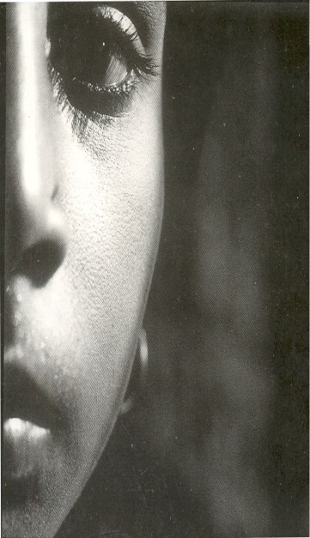

Gender in Mental Health
International Diploma in Mental Health, Human Rights and Law
Ratnaboli Ray, Ashoka Fellow
Founder and Managing Trustee
Mental Health Rights Organisation Calcutta
Pune, 2014

Slide 2
Anjali’s work
Institutions
Therapies, including skills training
‘Counselling’ and legal aid
Family tracing
Home visits
Community ‘awareness’
Employment and entrepreneurship
Reintegration
Follow up
Relationship management with hospital authorities
Community
Propagating awareness about mental health and illness
Training local women to be barefoot mental health professionals
Running mental health kiosks in collaboration with urban local bodies and Panchayats
Providing help, support and referrals to people in communities
Advocacy and Alliance Building
Workshops, Roundtables, Seminars,
Analysing Policies, Schemes
Engaging with Media

Slide 3
Big picture
Starting in adolescence, women suffer more than men from internalizing disorders.
Globalization has overseen a dramatic widening of inequality including gender-based income disparities.
Definitions of masculinity and femininity have psychological consequences

Slide 4
Being a woman
The decision about providing health care to the members of a family usually rests with the male heads of families.
In large joint families, where hierarchy and power equations are very strong, women usually reside in a very inferior place, especially the younger bahus. Interaction, even intimacy, between spouses is by protocol and is restricted to minimal and necessary contact.
Verbalising problems and conflicts is rare, so that it is very unlikely that men will know of the stresses or inner conflicts of the women.
Acknowledging inner conflicts usually connotes a sign of weakness, which is tolerated philosophically, but not treated as a health need. Especially in women, the acknowledgment of such problems would be considered as self- centredness.
Even though fewer women get admitted to mental hospitals for care, once there they stay for a longer period of time. The reasons for this range from the economic to the attitudes of hospital staff towards ‘appropriate feminine’ behaviour. The ideal woman patient is expected to be compliant, patient, passive, dependent and submissive.

Slide 5
Determinants of gender discrimination in mental health
Social stigma attached to mental illness
Rejection by family and community even after recovery
Gender bias in admission and care
Lack of knowledge, skills amongst professionals
Shortage of mental health services and infrastructure
Patriarchal Values

Slide 6
Gender in Psychiatry
The advent of psychiatry has been a rigid Western, patriarchal domain. At the spread of asylums in the 19th Century, women who were found protesting against the hostilities of men and social norms were confined to mental institutions and labeled as ‘mad women.’ Hysteria became known as a women’s problem whose only cure was finding a man
Women are diagnosed far more easily, with severe illnesses, when compared with men. Seen as weak and irrational, women’s expressions of sadness and anger are immediately labeled as depression, borderline personality syndrome, and psychosis. Studies globally show 48% more women being on psychotropic medicines than men
Recovery from mental illness too favours men more than women. Social factors such as support, employment, freedom, are more easily available . Men are rarely dumped and have much more support during their illness. There is less stigma , and men receive better behaviour from doctors, nurses and the society

Slide 7
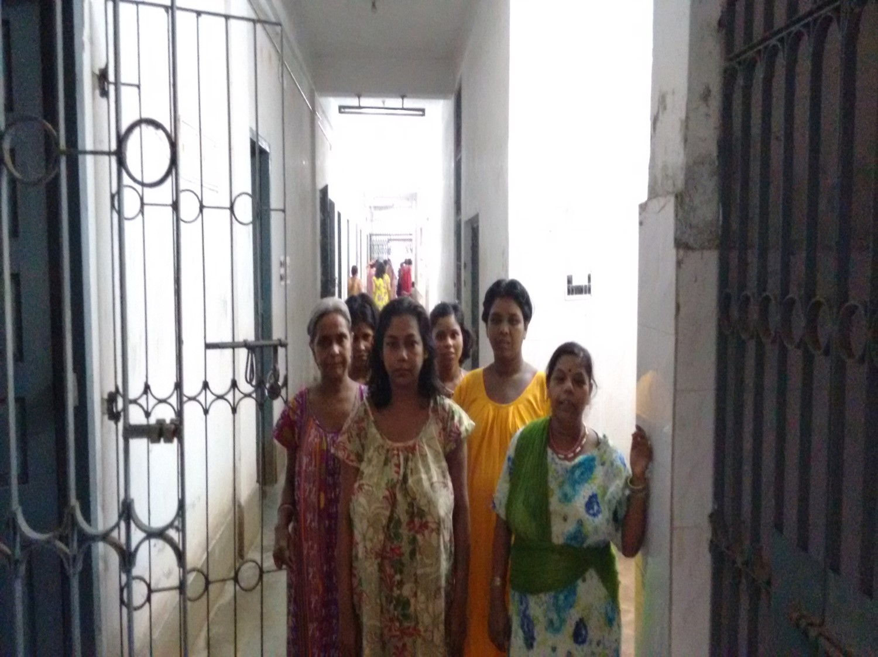
Women in institutions
Clothing, hygiene, personal care, privacy in short supply.
Dignity is in short supply.

Slide 8
Women are by far the primary recipients of psychiatric “services,”
Female gender is a significant predictor of being prescribed psychotropic drugs.
Women are seen to be more easily diagnosed and put on medication.
Women are dumped into mental institutions as soon as they are unable to perform their gender prescribed roles. They are hardly then looked back upon.
Women in institutions are disregarded, uncared for, untended to.
Once the family dumps a woman, the institutions too refuses to take any responsibility.

Slide 9
Mental institutions rob a woman of her personhood. Their heads are tonsured so that they don’t appear attractive.
Clothes are torn, tattered, dull, and shapeless.
There are no restrictions when it comes to keeping them in the nude; a practice seen in possibly every female psychiatric ward.
Active violence including sexual and physical abuse is a common phenomenon in State run mental institutions, as is the violation of freedom, when an individual is confined to one tiny cell for days on end.
Passive violence includes physical and emotional neglect

Slide 10
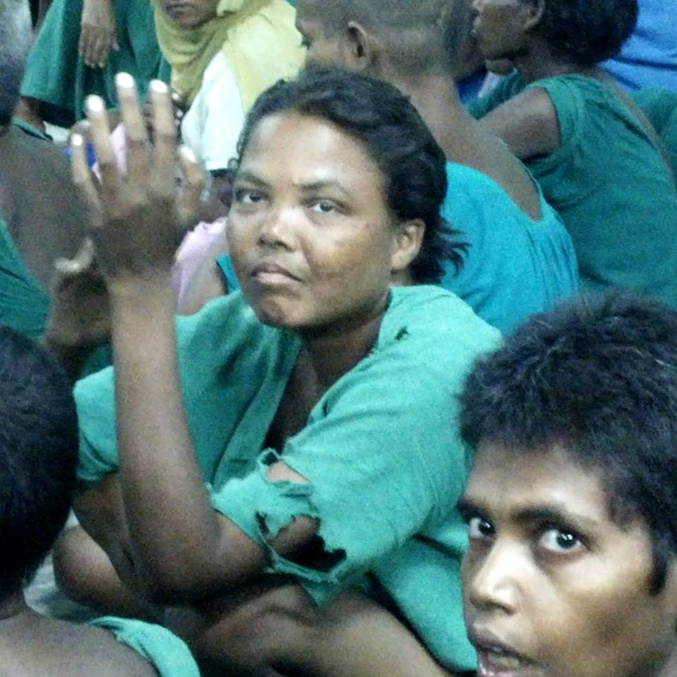

Slide 11
There is wide neglect and apathy. Women are seen as a burden and non-productive.
Threats of physical harm continue to be part of the lingo. Women are regularly threatened verbally and physically.
Women in mental hospitals are put through rigid paternalistic scrutiny and surveillance.
Sexuality of Women in mental hospitals is looked at as part of their ‘illness’

Slide 12
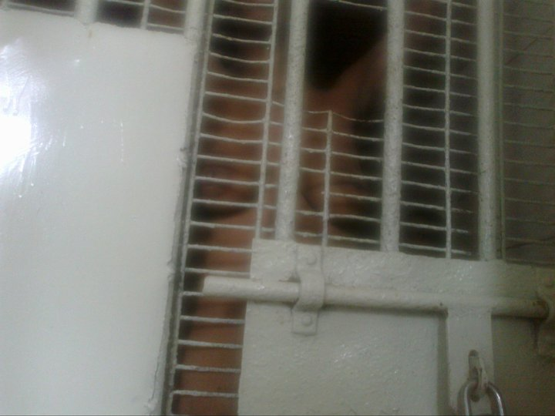
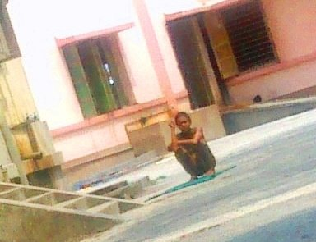
Notes:
Clothes, Hygiene , lack of privacy,

Slide 13
“I used to hesitate in disclosing to people about my depression. I was afraid of being judged by others, employers, friends… on top of having to deal with depression, I had to deal with how others perceived me as well- it made for a lot of work and recovery does not come easy…”
Ratnaboli Ray

Slide 14
Understanding stigma through a gender lens
Stigma exists within a social power structure that facilitates it
Stigmatization is contingent on access to social, economic, and political power that allows the full execution of disapproval, rejection, exclusion, and discrimination.
Misuse of power is the most damaging aspect of stigma

Slide 15
Gender in Society
Viewing health and health-seeking behaviour entails a closer understanding of women’s access, affordability, and appropriateness
Given gender role stereotype viewing a woman’s role to be that of a procreator and caregiver, reproductive health is seen to be the only appropriate aspect of health
Gender hierarchy in society enables men to be vocal about their mental health concerns
Typical gender prescribed roles, violence in marriage, poor psychological health, all contribute to higher thresholds of emotional distress and shame in seeking help

Slide 16
Patriarchy ensures that women with mental illness hardly receive adequate treatment
Women are expected to carry out their chores even when they are unwell
Even when women are reintegrated with their families, her whole family is at a risk to be discriminated against, which results in her family either hiding her condition or mistreating her
A woman with mental illness as well as a recovered woman are looked at with scorn

Slide 17
Jhilmil’s story
“My whole body was revolting…I was bleeding from everywhere...I hoped for support, but unfortunately I got none.”
The husband is diagnosed with Dengue and hospitalised. Receiving no information from the hospital authorities and fearing the worst and the subsequent consequences for her 4 boys and herself, she starts ‘demanding’ paperwork on her husband from the doctors.
Her ‘unwomanly’ aggressive behaviour demanding answers is enough to convince the doctors that she is mentally unstable and she is admitted into a mental hospital and diagnosed with Bipolar Disorder.
“My boys have been taken away from me; I am fighting a messy custody battle in court; just a week before the court hearing on the issue 6 police people come to the house - I was then living with my parents. They took me away against my wish to IBHAS, a Govt mental health facility, and locked me up”.

Slide 18
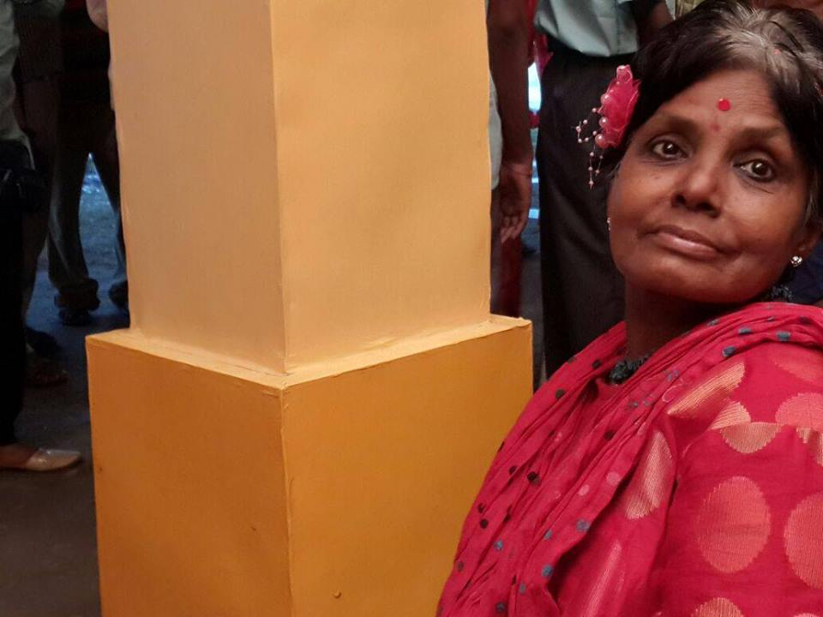
“I want to feel valuable because I am valuable”

