Slide 2
Access to Mental Health Care in Low Resource Settings: Problems & Potential Solutions
ALBERTO MINOLETTI

Slide 3
General Comment No. 14 (2000) : The right to the highest attainable standard of health (article 12 of the International Covenant on Economic, Social and Cultural Rights)
(a) Availability: health-care facilities, services, and programs have to be available in sufficient quantity
(b) Accessibility: facilities and services have to be accessible to everyone, with:
  non-discrimination (especially the most vulnerable or marginalized ones),
  physical accessibility,
  economic accessibility (affordability) and
  information accessibility
(c) Acceptability: respectful of medical ethics and culturally appropriate
(d) Quality: scientifically and medically appropriate

Slide 4
1. AVAILABILITY OF MENTAL HEALTH FACILITIES

Slide 5
PERCETAGE OF PRIMARY CARE FACILITIES
WITH MENTAL HEALTH MANUALS BY COUNTRY
INCOME (HEALTH ATLAS, WHO 2011)

Slide 6
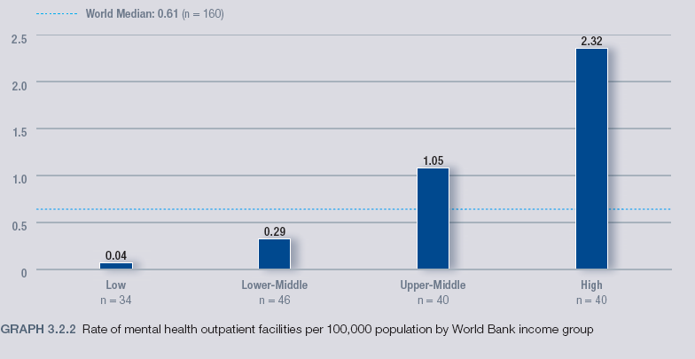
RATE OF MENTAL HEALTH OUTPATIENT FACILITIES
PER 100,000 BY INCOME
(HEALTH ATLAS, WHO 2011)

Slide 7
RATE OF DAY TREATMENT FACILITIES PER
100,000 BY INCOME (HEALTH ATLAS, WHO 2011)

Slide 8
MEDIAN RATE OF PSYCH BEDS IN GENERAL
HOSPITAL PER 100,000 BY INCOME
(HEALTH ATLAS, WHO 2011)

Slide 9
2. ACCESIBILITY TO MENTAL HEALTH FACILITIES

Slide 10
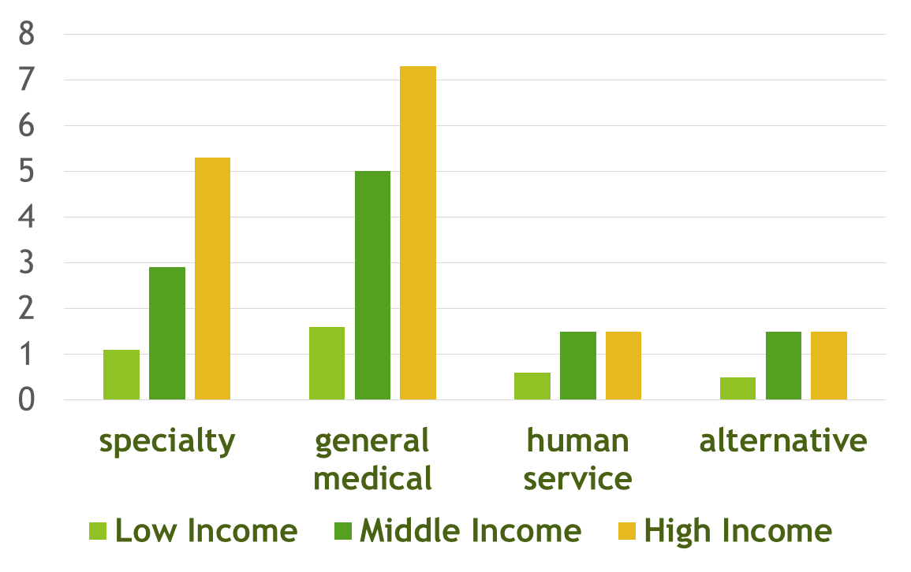
Treatment of 12-month DSM-IV disorders (%) by service sector and by country income (Wang et al, 2011, WHO Survey in 24 countries)

Slide 11
ANNUAL RATE OF PERSONS PER 100,000 TREATED
IN MH DAY TREATMENT FACILITIES BY INCOME
(HEALTH ATLAS, WHO 2011)

Slide 12
ANNUAL RATE OF ADMISSIONS TO PSYCH BEDS IN
GENERAL HOSPITALS PER 100,000
BY INCOME (HEALTH ATLAS, WHO 2011)

Slide 13
MEDIAN RATE OF PERSONS STAYING IN COMMUNITY
RESIDENTIAL FACILITIES PER 100,000 TREATED
BY INCOME (HEALTH ATLAS, WHO 2011)

Slide 14
3. BARRIERS FOR SCALING UP MENTAL HEALTH SERVICES IN LOW AND MIDDLE INCOME COUNTRIES

Slide 15
Barriers to improvement of mental health services in low-income and middle-income countries
Benedetto Saraceno, Mark van Ommeren, Rajaie Batniji, Alex Cohen, Oye Gureje, John Mahoney, Devi Sridhar, Chris Underhill
Lancet 2007; 370: 1164–74
Qualitative survey of international mental health experts and leaders

Slide 16
Barriers to improvement of services and challenges to overcoming them
Barrier
Challenges to overcoming barriers
Insufficient funding for mental health services
Inconsistent and unclear advocacy
People with mental disorders are currently not a sufficiently powerful lobby
Lack of general public interest in mental health
Social stigma
Incorrect belief that care is not cost effective

Slide 17
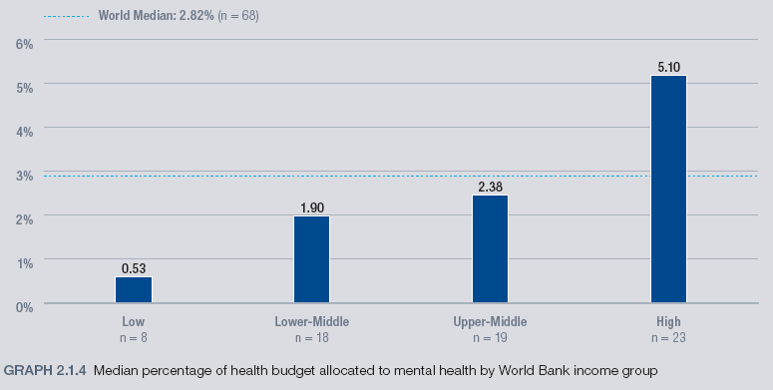
MENTAL HEALTH ATLAS, WHO 2011: % OF HEALTH BUDGET ALLOCATED TO MH

Slide 18
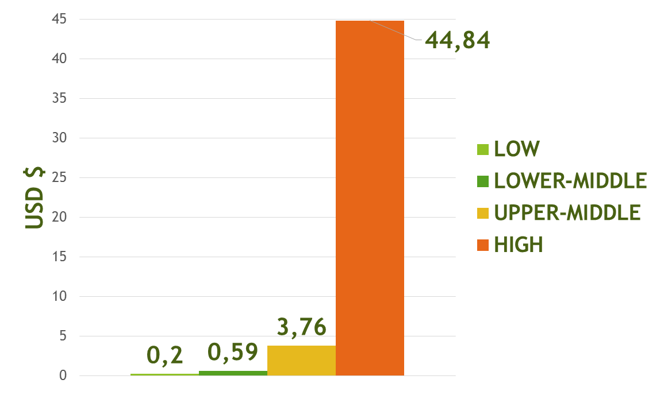
Median mental health expenditures per capita by income group (USD). Morris et al. Public Health Reviews 2012 (MH Atlas 2011)

Slide 19
Barriers to improvement of services and challenges to overcoming them
Barrier
Challenges to overcoming barriers
2. Mental health resources centralised in and near big cities and in large institutions
Historical reliance on mental hospitals
Differences between central and provincial government priorities
Vested interests of MH professionals and workers in continuity of large hospitals
Political risk associated with trade union protests
Need for transitional funding to shift to community-based services

Slide 20
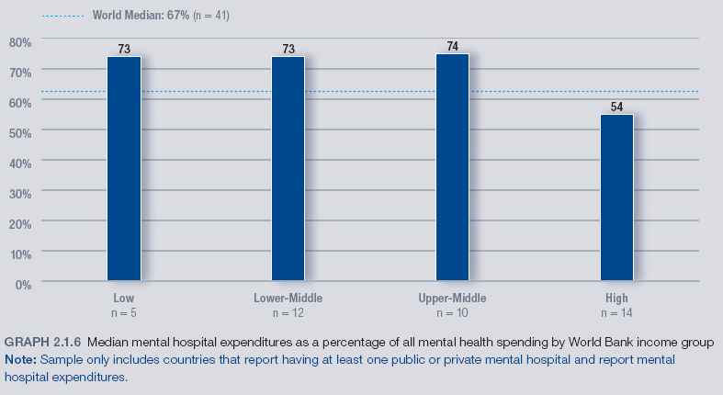
MENTAL HEALTH ATLAS, WHO 2011:
MENTAL HOSP EXPENDITURE (% of all MH)

Slide 21
Barriers to improvement of services and challenges to overcoming them
Barriers
Challenges to overcoming barriers
3. Complexities of integrating mental health care effectively in
primary-care services
Primary-care workers already overburdened
Lack of supervision and specialist support after training
Lack of continuous supply of psychotropics in primary care

Slide 22
Barriers to improvement of services and challenges to overcoming them
Barriers
Challenges to overcoming barriers
4. Low numbers and limited types of health workers trained and supervised in
mental health care
Poor working conditions in public mental health services
Lack of incentives to work in rural areas
Professional establishment opposes role for non-specialists
Medical students and psychiatric residents trained only in mental hospitals
Mental health specialists spend time providing care rather than training and supervising others

Slide 23
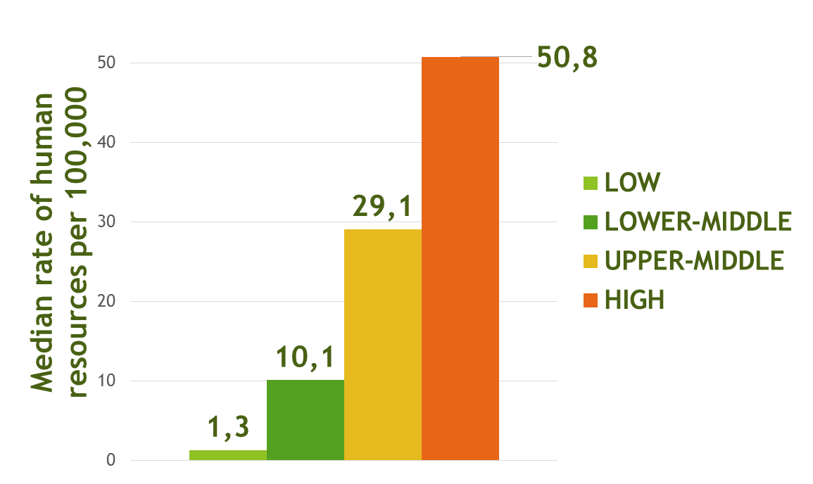
Median rate of human resources for MH per 100,000 by income group. Morris et al. Public Health Reviews 2012 (MH Atlas 2011)

Slide 24
Median rate of human resources per 100,000 population working in the mental health sector by profession and income group (WHO MH Atlas 2011)

Slide 25
Barriers to improvement of services and challenges to overcoming them
Barriers
Challenges to overcoming barriers
5. Mental health leaders
often deficient in public health skills and experience
Leaders often only trained in clinical management
Public-health training does not include mental health
Resistance of psychiatrists to accept other as leaders.
Lack of training courses in public mental health
Leaders overburdened by clinical and management responsibilities and private practices

Slide 26
4. What can be done to improve access IN LOW resource settings?

Slide 27
Scale up of services for mental health in low-income and
middle-income countries
Julian Eaton, Layla McCay, Maya Semrau, Sudipto Chatterjee, Florence Baingana, Ricardo Araya, Christina Ntulo, Graham Thornicroft, Shekhar Saxena
A systematic review of the published and grey literature.
A survey to expert key informants with knowledge at the national level of mental health services in LAMIC
Lancet 2011; 378: 1592–603. Published Online October 17, 2011. DOI:10.1016/S0140-6736(11)60891-X

Slide 28
Lessons learned for scaling up MH services 1
Evidence that political leaders and decision makers are giving increased priority to mental health care in some countries
The ned to scale up evidence based services in LAMIC has started to be translated into policy, legislation and programmes
Increase in funding by some international development and research agencies

Slide 29
Lessons learned for scaling up MH services 2
Reorganisation of services by decentralisation and integration into primary health care
Models of service delivery (well designed trials of complex interventions)
Understanding of the policy environment needed to make scaling up more feasible.
Engagement with the whole health system to ensure resources (personnel training and medicine supply)

Slide 30
Typology of mental health disorders in primary care Bower, BMJ 2005;330:839–42
Description | Example disorders | Care
1. Severe mental disorders, unlikely to remit spontaneously, major disability | Schizophrenia, organic disorders, bipolar disorder | Involves both primary and secondary care
2.Well defined disorders, disability, with effective pharmacological and psychological treatments. Relapse is common | depression, generalised anxiety, panic disorder, obsessive-compulsive disorder | Can usually be managed entirely within PHC
3. Disorders with limited role for drugs, respond to psychological therapies | Phobias, somatization, eating disorder, chronic fatigue | Rarely treated within PHC; few cases with specialists
4. Disorders that tend to resolve spontaneously | Bereavement, adjustment disorder | Simple supportive help is needed

Slide 31
WHO Pyramid Framework modified by Minoletti
HIGH
LOW
Hospital
care
Day care
Community MH teams & social support services
PHC services for MH & social support services
Informal community care
Self-care
FRECUENCY OF NEED
COSTS
LOW
HIGH
QUANTITY OF SERVICES NEEDED

Slide 32
Informal community care
Who?
What?
Teachers
Social workers
Police
Community workers
User and family groups
Mutual-help groups
Traditional healers
NGOs
Prevention (e.g. legal & emotional support for women victims of violence)
Treatment (e.g. providers, case management, etc.)
Recovery (e.g. modeling, support provider)
Advocacy (e.g. persons with mental disability)

Slide 33
How can PHC workers enhance MH informal community care
Indentifying and supporting community initiatives that improve MH
Empowering community organizations: users, families, people with similar MH problems or disorders
Avoiding dependency relationships with the community and promoting autonomy

Slide 34
Lessons learned for scaling up MH services 3
Task sharing is the means to most efficiently use low numbers of trained personnel
A high proportion of need can be met with simple packages of care delivered in non-hospital settings by non-specialists.
Primary health level staff need to be better trained and supported to identify and manage mental disorders.

Slide 35
Examples of human resources for MH in PHC according to the level of health resources
Low level of resources | Middle level of resources | High level of resources
Nurse Nurse assistance Health community workers Users & families | General physician Nurse or MH nurse Social worker Nurse assistance Psychosocial technician Health community workers Users & families | Family doctor, pediatrician , etc. MH nurse Social worker Psychologist therapist or counselor Nurse assistance Case manager Users & families

Slide 37
Lessons learned for scaling up MH services 4
Specialist mental health staff are needed at the district level (preferably a multidisciplinary team, but at least a prescribing clinician)
Decentralisation of any mental health expertise to district level have an enormous effect on access to care.
Specialist staff would not only provide clinical services, training, and supervision for primary care staff but also a managerial function to ensure that the health system facilitates integration of MH services.

Slide 38
Stepped care (Milbank Memorial Fund 2010)
First step: basic educational efforts, such as sharing information and referral to self-help groups.
Second step: clinicians provide psycho-educational interventions and make follow-up phone calls.
Third step: involves more highly trained professionals who use specific practice algorithms (medication and/or CBT).
Fourth step: If a patient does not respond to these progressions of care (or if specialized treatment is needed), the patient is then referred to the specialty mental health system

Slide 39
model of consultation-liaison
the PHC provider delivers the MH service while receiving consultative support from a psychiatrist or other MH professional
the goal is to enhance the PHC provider’s ability to treat patients with MH issues within a PHC setting
the psychiatrist works solely as a consultant to the PHC provider, seeing patients with the physician or more commonly advising via telephone, but not co-managing the patient
brief intervention guidelines for PHC

Slide 41
RATE OF MENTAL MH OUTPATIENT FACILITIES
IN LATIN AMERICA PER 100,000 AND LEVEL
OF UTILIZATION (MINOLETTI ET AL)

Slide 42
Important steps in strategic scaling up of mental health services in low-income and middle-income settings (Julian Eaton et al)
Situational analysis
Planning
Implementation
Evaluation

Slide 43
Important steps in strategic scaling up of mental health services in low-income and middle-income settings (Julian Eaton et al)

Slide 44
Important steps in strategic scaling up of mental health services in low-income and middle-income settings (Julian Eaton et al)

Slide 45
Important steps in strategic scaling up of mental health services in low-income and middle-income settings (Julian Eaton et al)

Slide 46
Important steps in strategic scaling up of mental health services in low-income and middle-income settings (Julian Eaton et al)

Slide 47
Thank you!

