Slide 2
Interaction between human rights and mental health
Alberto Minoletti

Slide 3
Understanding the interaction between human rights and mental health
The themes for this lecture:
Mental health policy, law & practice affect human rights
Human rights violations affect mental health
Human rights violations of people with mental disabilities are highly prevalent
WHO QualityRights tool
Notes:
In this talk I want to explore some of the overarching issues related to mental health and human rights
I first want to look at the inter-relationship or different links between human rights and mental health
In the second part I will run through some of the human Rights violations that people with mental disabilities are exposed to in countries all over the world including:
in terms of access to care
Violations within the health care context
The discrimination and human rights in the community context

Slide 4
Mental health policy, laws and
practice impacts on human rights
Mental health policies & laws give power to government to take decisions about individuals basic rights (e.g. autonomy, bodily integrity, privacy, self determination, liberty, etc.).
Mental health workers also exercise a power by taking decisions about individuals basic rights in their everyday practice (e.g. freedom, voting, managing financial affairs, etc.).
voting
Notes:
4
So the first relationship is that mental health policies, laws and practices can impact human rights.
Mental health policies and laws quintessentially involve the exercise of government power – the power to restrain, to treat, and to deprive people of their basic rights such as the right to vote, to manage ones financial and personal affairs.
Although mental health powers may be exercised for the welfare of the individual as well as the family and society, these powers can by there very nature affects a variety of personal interests and fundamental rights – among them autonomy, bodily integrity, privacy, self determination and liberty.
These powers can, and do, give rise to human rights violations when mental health powers are exercised arbitrarily, in a discriminatory manner, or in the absence of a fair process.
Eg. We see very often people with mental disabilities being arbitrarily admitted in psych institutions, treated against their will, without proper assessment, criteria, without possibility to appeal, and without systematic review of their cases

Slide 5
Mental health policy, laws and
practice impacts on human rights
Although Government and mental health workers can exercise power well intentioned and for the welfare of individuals, the result can be:
Promotion of rights
Violation of rights
Notes:
5
So the first relationship is that mental health policies, laws and practices can impact human rights.
Mental health policies and laws quintessentially involve the exercise of government power – the power to restrain, to treat, and to deprive people of their basic rights such as the right to vote, to manage ones financial and personal affairs.
Although mental health powers may be exercised for the welfare of the individual as well as the family and society, these powers can by there very nature affects a variety of personal interests and fundamental rights – among them autonomy, bodily integrity, privacy, self determination and liberty.
These powers can, and do, give rise to human rights violations when mental health powers are exercised arbitrarily, in a discriminatory manner, or in the absence of a fair process.
Eg. We see very often people with mental disabilities being arbitrarily admitted in psych institutions, treated against their will, without proper assessment, criteria, without possibility to appeal, and without systematic review of their cases

Slide 6
1. Mental health policy, laws and practice impacts on human rights
If we believe that people with mental disabilities are incompetent, potentially dangerous and violent, we are going to emphasize protection (and we may protection of the general public).
If we believe that people with mental disabilities are citizens with rights equal to others, we are going to emphasize support to fully exercise their rights.
Notes:
6
So the first relationship is that mental health policies, laws and practices can impact human rights.
Mental health policies and laws quintessentially involve the exercise of government power – the power to restrain, to treat, and to deprive people of their basic rights such as the right to vote, to manage ones financial and personal affairs.
Although mental health powers may be exercised for the welfare of the individual as well as the family and society, these powers can by there very nature affects a variety of personal interests and fundamental rights – among them autonomy, bodily integrity, privacy, self determination and liberty.
These powers can, and do, give rise to human rights violations when mental health powers are exercised arbitrarily, in a discriminatory manner, or in the absence of a fair process.
Eg. We see very often people with mental disabilities being arbitrarily admitted in psych institutions, treated against their will, without proper assessment, criteria, without possibility to appeal, and without systematic review of their cases

Slide 7
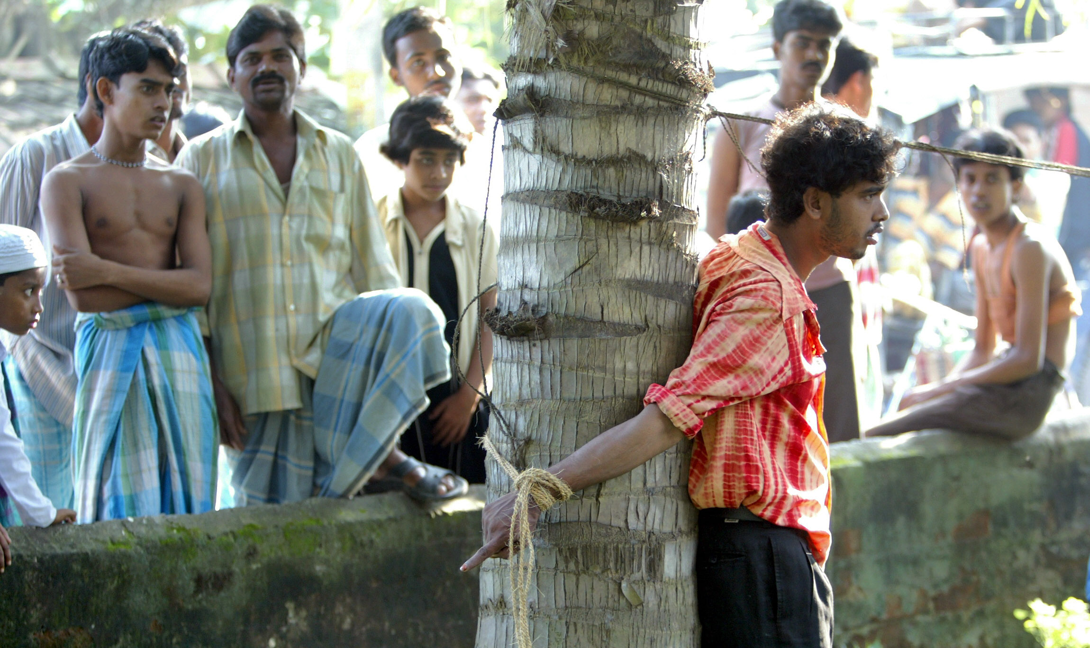

Slide 8
Mental health policy, laws and
practice impacts on human rights
To prevent human rights violations we need to work in 2 levels:
Mental Health Policy & Laws: Government responsibility
Local Practice: general health and mental health workers
Notes:
8
So the first relationship is that mental health policies, laws and practices can impact human rights.
Mental health policies and laws quintessentially involve the exercise of government power – the power to restrain, to treat, and to deprive people of their basic rights such as the right to vote, to manage ones financial and personal affairs.
Although mental health powers may be exercised for the welfare of the individual as well as the family and society, these powers can by there very nature affects a variety of personal interests and fundamental rights – among them autonomy, bodily integrity, privacy, self determination and liberty.
These powers can, and do, give rise to human rights violations when mental health powers are exercised arbitrarily, in a discriminatory manner, or in the absence of a fair process.
Eg. We see very often people with mental disabilities being arbitrarily admitted in psych institutions, treated against their will, without proper assessment, criteria, without possibility to appeal, and without systematic review of their cases

Slide 9
1. Mental health policy, laws and practice impacts on human rights: Government responsibility
Examples of Civil & Political Rights (ICCPR) | Examples of Economic, Social & Cultural Rights (ICESCR)
To liberty & security To a fair trial To vote To protection from cruel, inhuman or degrading treatment To marry and to found a family | To an adequate standard of living To the highest attainable standard of physical & mental health To education To work

Slide 10
1. MH policy, laws and practice impacts on human rights: Health & MH workers responsibility
THE 3 ACES FOR LOCAL PRACTICE (Thornicroft & Tansella, 2009)
ACE 1 | ACE 2 | ACE 3
AUTONOMY | ACCESIBILITY | ACCOUNTABILITY
CONTINUITY | COMPREHENSIVENESS | CO-ORDINATION
EFFECTIVENESS | EQUITY | EFFICIENCY

Slide 11
2. Human rights violations affect
mental health
Extreme forms of human rights violations
Poverty
Stigmatization and discrimination
Restrictions in civil liberties
Detrimental to mental health
Notes:
11
The second relationship - violations of human rights can adversely affect the mental health of people in direct and indirect ways.
Extreme forms of human rights violations, including physical violence, rape, torture, genocide, war, and inhuman and degrading treatment, cause direct, obvious and serious mental health problems to victims and their families including anxiety, stress and depression.
Research has indicated that an estimated 10% of people who experienced traumatic events go on to develop serious mental health problems, and another 10% may have difficulty functioning effectively due to depression, anxiety, psychosomatic problems, etc. (Murthy, R.S. & Lakshminarayana. (2006). Mental health consequences of war: a brief review of research findings. World Psychiatry. 5(1): 25–30. Zambia.)
Research has likewise shown a high prevalence of depression and anxiety disorders among refugees and women who experience intimate partner violence.(Measuring Trauma and Health Status in Refugees. JAMA. 288:611-621.)
But it is not just extreme forms of human rights violations that have a negative impact on mental health.
Poverty: The link between poverty and increased risk of mental disorders is becoming more apparent. People living in poverty not only lack financial resources to maintain basic living standards but they also have fewer educational and employment opportunities. They are also exposed to adverse lviing environments such as slum areas or dwellings weithout sanitation or water and are less likely to access good quality health care. These stressfukl conditions place people at higher ris of developing a mental health condition,
Stigmatization, discrimination, marginalistaion against people with mental disabilities can adversely affect mental health. It leads to poor self esteem, low self confidence, reduced motivation, isolation .
Restrictions in civil liberties such as the right to vote, to take part in public affairs, to express one's opinion, to seek, receive and impart information, to manage ones personal/financial affairs, freedom of association, assembly and movement can also adversely affect the mental health of a population.
Without these freedoms an individual cannot participate in the community, be part of the decision-making process on issues that impact their lives, or improve their social and economic standing. This too negatively impacts mental health.

Slide 12
2. Human rights violations affect
mental health
Extreme forms of human rights violations
People who experienced serious traumatic events have a high risk to develop mental disorders and impaired social and occupational functioning
Physical violence, rape, torture, genocide, war, and inhuman and degrading treatment
Notes:
12
The second relationship - violations of human rights can adversely affect the mental health of people in direct and indirect ways.
Extreme forms of human rights violations, including physical violence, rape, torture, genocide, war, and inhuman and degrading treatment, cause direct, obvious and serious mental health problems to victims and their families including anxiety, stress and depression.
Research has indicated that an estimated 10% of people who experienced traumatic events go on to develop serious mental health problems, and another 10% may have difficulty functioning effectively due to depression, anxiety, psychosomatic problems, etc. (Murthy, R.S. & Lakshminarayana. (2006). Mental health consequences of war: a brief review of research findings. World Psychiatry. 5(1): 25–30. Zambia.)
Research has likewise shown a high prevalence of depression and anxiety disorders among refugees and women who experience intimate partner violence.(Measuring Trauma and Health Status in Refugees. JAMA. 288:611-621.)
But it is not just extreme forms of human rights violations that have a negative impact on mental health.
Poverty: The link between poverty and increased risk of mental disorders is becoming more apparent. People living in poverty not only lack financial resources to maintain basic living standards but they also have fewer educational and employment opportunities. They are also exposed to adverse lviing environments such as slum areas or dwellings weithout sanitation or water and are less likely to access good quality health care. These stressfukl conditions place people at higher ris of developing a mental health condition,
Stigmatization, discrimination, marginalistaion against people with mental disabilities can adversely affect mental health. It leads to poor self esteem, low self confidence, reduced motivation, isolation .
Restrictions in civil liberties such as the right to vote, to take part in public affairs, to express one's opinion, to seek, receive and impart information, to manage ones personal/financial affairs, freedom of association, assembly and movement can also adversely affect the mental health of a population.
Without these freedoms an individual cannot participate in the community, be part of the decision-making process on issues that impact their lives, or improve their social and economic standing. This too negatively impacts mental health.

Slide 13
Mental health consequences of war (Murthy, 2006)
Mental disorder | Prevalence (%)
Depression | 25 - 80
Anxiety Disorder | 51 - 72
Post – Traumatic Stress Disorder | 17 – 60
Somatization Disorder | 41
Alcohol (harmful use & dependence) | 15

Slide 14
Lifetime Prevalence of Gender-Based Violence in Women and the Relationship With Mental Disorders (Rees, JAMA 2011)
Gender –based violence | % of women age 16-85 (n=4,451)
Sexual assault | 14.7
Stalking | 10.0
Rape | 8.1
beaten by a spouse or romantic partner | 7.8
Any form of gender-based violence | 27.0

Slide 15
Lifetime Prevalence of Gender-Based Violence in Women and the Relationship With Mental Disorders (Rees, JAMA 2011)
Type of mental disorder | 1 gender-based crime (%) | 3-4 gender-based crime (%)
Anxiety disorder | 39 | 77
Post-traumatic disorder | 15 | 56
Mood disorder | 31 | 53
Substance use disorder | 23 | 47
Any disorder | 57 | 89

Slide 16
2. Human rights violations affect
mental health
Poverty
The link between poverty and increased risk of mental disorders is becoming more apparent.
Lack of financial resources to maintain basic living standards and fewer educational and employment opportunities.
Exposure to adverse living environments such as slum areas or dwellings without sanitation or water
Less access to good quality health care.
These stressful conditions place people at higher risk of developing a mental disorder
Notes:
16
The second relationship - violations of human rights can adversely affect the mental health of people in direct and indirect ways.
Extreme forms of human rights violations, including physical violence, rape, torture, genocide, war, and inhuman and degrading treatment, cause direct, obvious and serious mental health problems to victims and their families including anxiety, stress and depression.
Research has indicated that an estimated 10% of people who experienced traumatic events go on to develop serious mental health problems, and another 10% may have difficulty functioning effectively due to depression, anxiety, psychosomatic problems, etc. (Murthy, R.S. & Lakshminarayana. (2006). Mental health consequences of war: a brief review of research findings. World Psychiatry. 5(1): 25–30. Zambia.)
Research has likewise shown a high prevalence of depression and anxiety disorders among refugees and women who experience intimate partner violence.(Measuring Trauma and Health Status in Refugees. JAMA. 288:611-621.)
But it is not just extreme forms of human rights violations that have a negative impact on mental health.
Poverty: The link between poverty and increased risk of mental disorders is becoming more apparent. People living in poverty not only lack financial resources to maintain basic living standards but they also have fewer educational and employment opportunities. They are also exposed to adverse lviing environments such as slum areas or dwellings weithout sanitation or water and are less likely to access good quality health care. These stressfukl conditions place people at higher ris of developing a mental health condition,
Stigmatization, discrimination, marginalistaion against people with mental disabilities can adversely affect mental health. It leads to poor self esteem, low self confidence, reduced motivation, isolation .
Restrictions in civil liberties such as the right to vote, to take part in public affairs, to express one's opinion, to seek, receive and impart information, to manage ones personal/financial affairs, freedom of association, assembly and movement can also adversely affect the mental health of a population.
Without these freedoms an individual cannot participate in the community, be part of the decision-making process on issues that impact their lives, or improve their social and economic standing. This too negatively impacts mental health.

Slide 17
2. Human rights violations affect
mental health
Stigmatization and discrimination against people with mental disabilities and other minorities
Associated with alienation, despair, loss of dignity and self worth.
They lead to poor self esteem, low self confidence, reduced motivation, isolation
Self-stigma
All of these factors can adversely affect mental health.
Notes:
17
The second relationship - violations of human rights can adversely affect the mental health of people in direct and indirect ways.
Extreme forms of human rights violations, including physical violence, rape, torture, genocide, war, and inhuman and degrading treatment, cause direct, obvious and serious mental health problems to victims and their families including anxiety, stress and depression.
Research has indicated that an estimated 10% of people who experienced traumatic events go on to develop serious mental health problems, and another 10% may have difficulty functioning effectively due to depression, anxiety, psychosomatic problems, etc. (Murthy, R.S. & Lakshminarayana. (2006). Mental health consequences of war: a brief review of research findings. World Psychiatry. 5(1): 25–30. Zambia.)
Research has likewise shown a high prevalence of depression and anxiety disorders among refugees and women who experience intimate partner violence.(Measuring Trauma and Health Status in Refugees. JAMA. 288:611-621.)
But it is not just extreme forms of human rights violations that have a negative impact on mental health.
Poverty: The link between poverty and increased risk of mental disorders is becoming more apparent. People living in poverty not only lack financial resources to maintain basic living standards but they also have fewer educational and employment opportunities. They are also exposed to adverse lviing environments such as slum areas or dwellings weithout sanitation or water and are less likely to access good quality health care. These stressfukl conditions place people at higher ris of developing a mental health condition,
Stigmatization, discrimination, marginalistaion against people with mental disabilities can adversely affect mental health. It leads to poor self esteem, low self confidence, reduced motivation, isolation .
Restrictions in civil liberties such as the right to vote, to take part in public affairs, to express one's opinion, to seek, receive and impart information, to manage ones personal/financial affairs, freedom of association, assembly and movement can also adversely affect the mental health of a population.
Without these freedoms an individual cannot participate in the community, be part of the decision-making process on issues that impact their lives, or improve their social and economic standing. This too negatively impacts mental health.

Slide 18
2. Human rights violations affect mental health
Restrictions in civil liberties
The right
to express one's opinion,
to manage ones personal/financial affairs,
to vote,
to take part in public affairs,
To have freedom of association, assembly and movement
Without these rightss people cannot participate in the community,
be part of decision-making process on issues that impact their lives, or
improve their social and economic standing.
Negative impact on mental health.
Notes:
18
The second relationship - violations of human rights can adversely affect the mental health of people in direct and indirect ways.
Extreme forms of human rights violations, including physical violence, rape, torture, genocide, war, and inhuman and degrading treatment, cause direct, obvious and serious mental health problems to victims and their families including anxiety, stress and depression.
Research has indicated that an estimated 10% of people who experienced traumatic events go on to develop serious mental health problems, and another 10% may have difficulty functioning effectively due to depression, anxiety, psychosomatic problems, etc. (Murthy, R.S. & Lakshminarayana. (2006). Mental health consequences of war: a brief review of research findings. World Psychiatry. 5(1): 25–30. Zambia.)
Research has likewise shown a high prevalence of depression and anxiety disorders among refugees and women who experience intimate partner violence.(Measuring Trauma and Health Status in Refugees. JAMA. 288:611-621.)
But it is not just extreme forms of human rights violations that have a negative impact on mental health.
Poverty: The link between poverty and increased risk of mental disorders is becoming more apparent. People living in poverty not only lack financial resources to maintain basic living standards but they also have fewer educational and employment opportunities. They are also exposed to adverse lviing environments such as slum areas or dwellings weithout sanitation or water and are less likely to access good quality health care. These stressfukl conditions place people at higher ris of developing a mental health condition,
Stigmatization, discrimination, marginalistaion against people with mental disabilities can adversely affect mental health. It leads to poor self esteem, low self confidence, reduced motivation, isolation .
Restrictions in civil liberties such as the right to vote, to take part in public affairs, to express one's opinion, to seek, receive and impart information, to manage ones personal/financial affairs, freedom of association, assembly and movement can also adversely affect the mental health of a population.
Without these freedoms an individual cannot participate in the community, be part of the decision-making process on issues that impact their lives, or improve their social and economic standing. This too negatively impacts mental health.

Slide 19
3. Human rights violations of people with mental disabilities
Violations in access to care 1
unavailable – inaccessible – unacceptable – poor quality
Mental health low priority, poorly funded in most countries (less than 2% of health budget in low and low-middle income countries)
Lack of mental health services
Services available only to certain segments of population
Services are unaffordable (paid from out-of-pocket)
Violation of the right to mental health

Slide 20
3. Human rights violations of people with mental disabilities
Violations in access to care 2
Health insurance schemes exclude/lower level of mental health care coverage
'Care' is inappropriate and sometimes harmful
health care staff inadequately trained (misdiagnosis, wrong medication or over medication)
traditional or spiritual healing not well regulated
Lack of access to care leads to clinical deterioration, marginalisation, homelessness

Slide 21
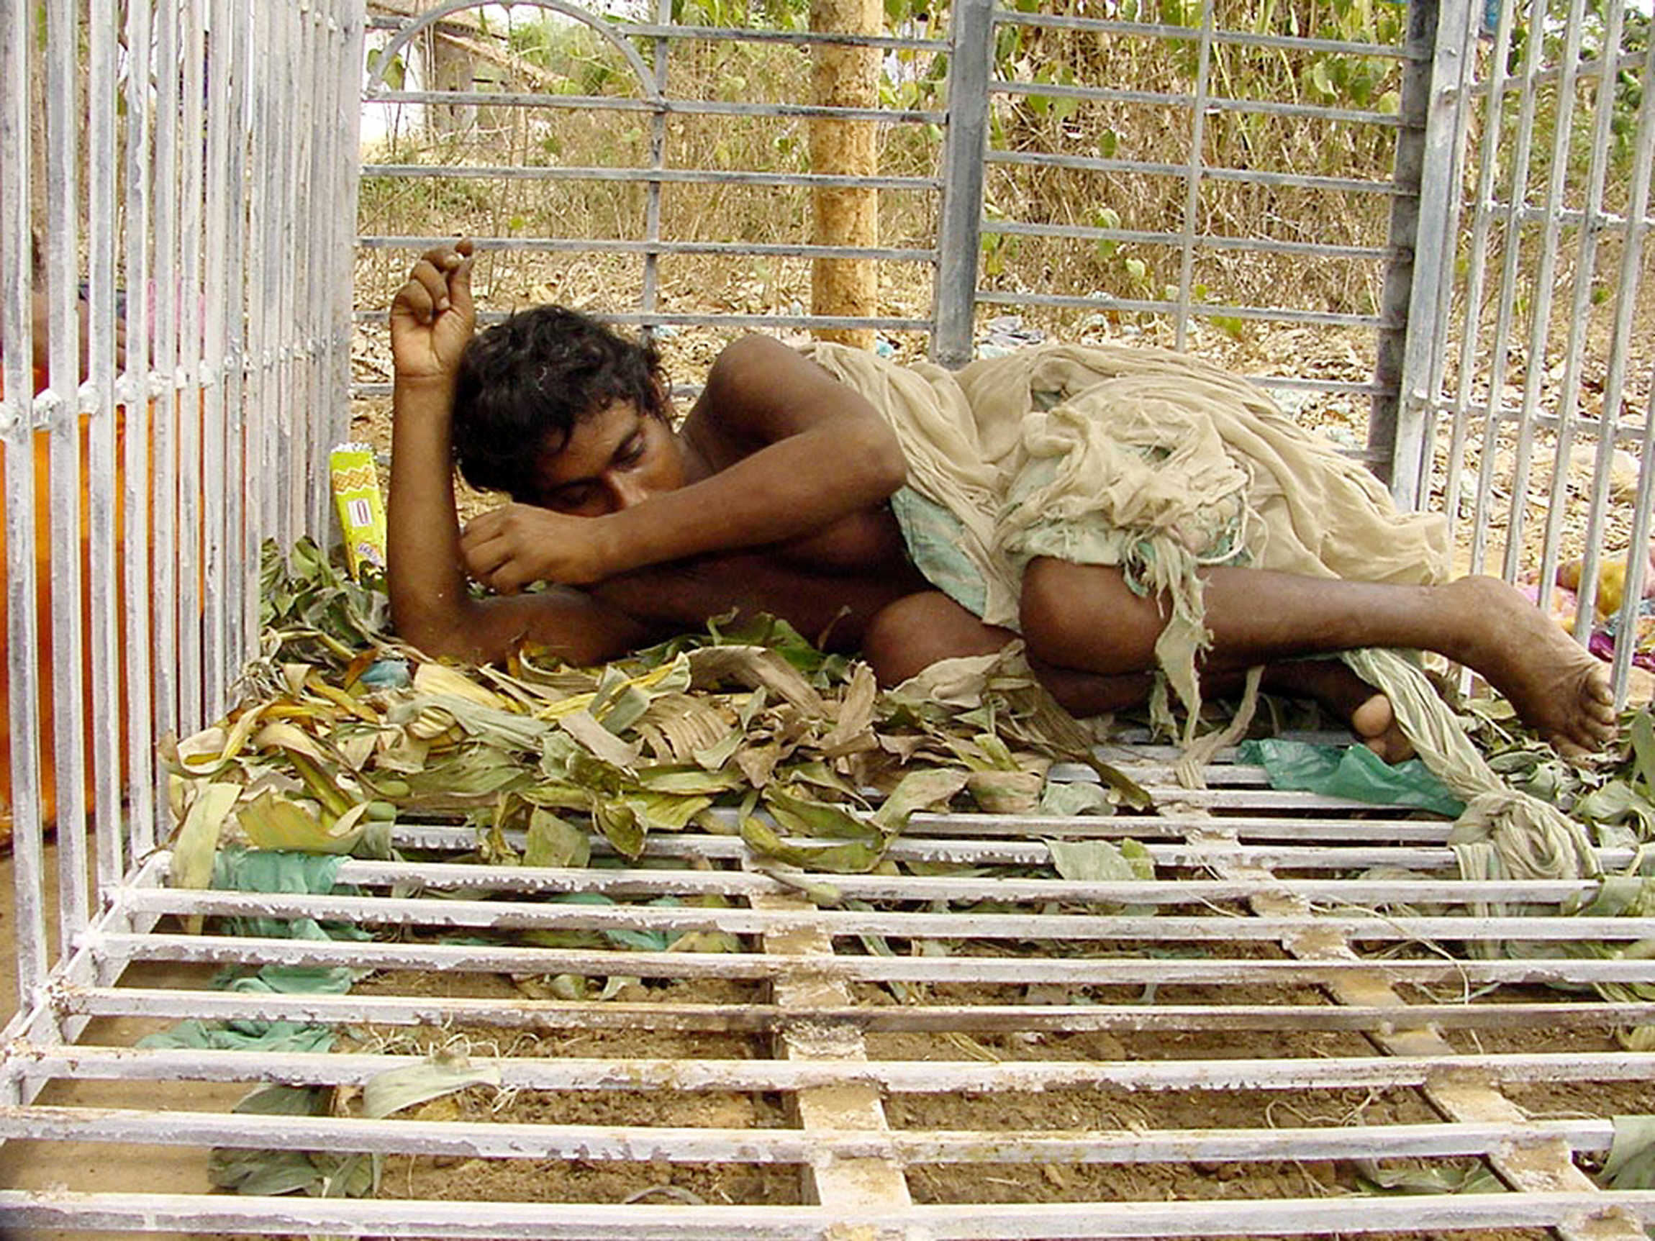

Slide 22
3. Human rights violations of people with mental disabilities
Violations in the mental health care context 1
Appalling living conditions in psychiatric institutions
Buildings are decrepit and filthy, poor sanitation and hygiene
People lack proper clothes, clean water, food, heating, decent bedding or privacy
It is not just a matter of resources (inferior quality than physical health institutions)
Notes:
Violations in the mental health care context
As we've seen in pandit lecture and in film Michelle showed people with mental disabilities experience terrible human rights violations in psychiatric institutions.
I won't go over these again in detail, but just to highlight the overarching issues, that people in institutions live in:
Appalling living conditions
Buildings are decrepit and filthy, poor sanitation and hygiene
People lack proper clothes, clean water, food, heating, decent bedding or privacy
Inhuman and degrading treatment:
Abusive use of seclusion and restraints
Violence and rape
No stimulation
Over-medication
************************************************
Patients in many mental health facilities around the world experience appalling living conditions:
Buildings are decrepit and filthy, lacking even basic sanitation and hygiene standards.
People do lack proper clothes, clean water, food, heating, decent bedding or privacy.
There was a recent report (Feb 2004) for example of 18 people dying in an institution in Roumania due to of hypothermia and malnutrition)
Many people living in psychiatric institutions are exposed inhumane or degrading treatment, physical, sexual and mental abuse and neglect:
Abusive use of seclusion and restraints are common practice in certain facilities. Patients are locked away in small, prison-like rooms for long periods of time with no human contact. Sometimes, adults and even young children are locked up in caged beds with no hope of movement all day.
examples of more harmful, inhuman practices which are still prevalent in Europe (Turkey, Romania, Czech; Slovakia and Slovenia)…(In paraguay a very recent report showed that children with autism are locked away in tiny cells for years – in one case 4 years – where they are not even let out to go to the toilet so have to live in cells filled with their own excrement and urine)
In some institutions, adults and children are subjected to horrific violence and rape — sometimes at the hands of the very people who should be caring for them. These practices often go unreported and unpunished, leaving the perpetrators free to continue the abuse.
Many people living in institutions receive no form of stimulation, and spend days, months and even years living in excruciating boredom.
Some people are over-medicated so that they remain docile and 'easy to manage'.

Slide 23
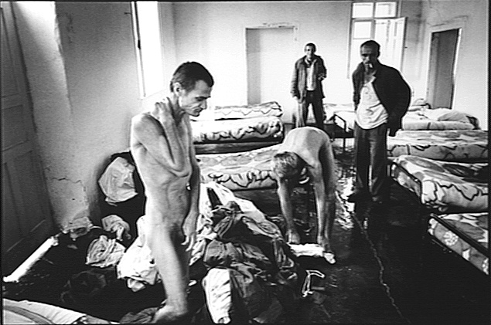
Notes:
Human rights violations: inhuman living conditions
psychiatric institutions tend to be more like human warehouses than places of care and treatment.
The buildings are decrepit and filthy.
People lack proper clothes, clean water, and food. They also lack respect for their dignity.
Again, these conditions can only lead to a worsening of the mental disorder and overall health. (Feb 2004 18 people died in inst in Romania of hypothermia and malnutrition)
When the treatment settings are so appalling, it is quite easy to understand why people do not seek help, and why people actively resist treatment. It also explains why so few health care staff want to work in the area of mental health.

Slide 24
3. Human rights violations of people with
mental disabilities
Violations in the mental health
care context 2
Inhuman and degrading treatment:
Abusive use of seclusion and restraints
Violence and rape (unreported & unpunished)
No stimulation (no real treatment)
Over-medication (easy to manage)
Reports from mental institutions have denounced people dying due malnutrition or lack of medical care
Notes:
Violations in the mental health care context
As we've seen in pandit lecture and in film Michelle showed people with mental disabilities experience terrible human rights violations in psychiatric institutions.
I won't go over these again in detail, but just to highlight the overarching issues, that people in institutions live in:
Appalling living conditions
Buildings are decrepit and filthy, poor sanitation and hygiene
People lack proper clothes, clean water, food, heating, decent bedding or privacy
Inhuman and degrading treatment:
Abusive use of seclusion and restraints
Violence and rape
No stimulation
Over-medication
************************************************
Patients in many mental health facilities around the world experience appalling living conditions:
Buildings are decrepit and filthy, lacking even basic sanitation and hygiene standards.
People do lack proper clothes, clean water, food, heating, decent bedding or privacy.
There was a recent report (Feb 2004) for example of 18 people dying in an institution in Roumania due to of hypothermia and malnutrition)
Many people living in psychiatric institutions are exposed inhumane or degrading treatment, physical, sexual and mental abuse and neglect:
Abusive use of seclusion and restraints are common practice in certain facilities. Patients are locked away in small, prison-like rooms for long periods of time with no human contact. Sometimes, adults and even young children are locked up in caged beds with no hope of movement all day.
examples of more harmful, inhuman practices which are still prevalent in Europe (Turkey, Romania, Czech; Slovakia and Slovenia)…(In paraguay a very recent report showed that children with autism are locked away in tiny cells for years – in one case 4 years – where they are not even let out to go to the toilet so have to live in cells filled with their own excrement and urine)
In some institutions, adults and children are subjected to horrific violence and rape — sometimes at the hands of the very people who should be caring for them. These practices often go unreported and unpunished, leaving the perpetrators free to continue the abuse.
Many people living in institutions receive no form of stimulation, and spend days, months and even years living in excruciating boredom.
Some people are over-medicated so that they remain docile and 'easy to manage'.

Slide 25
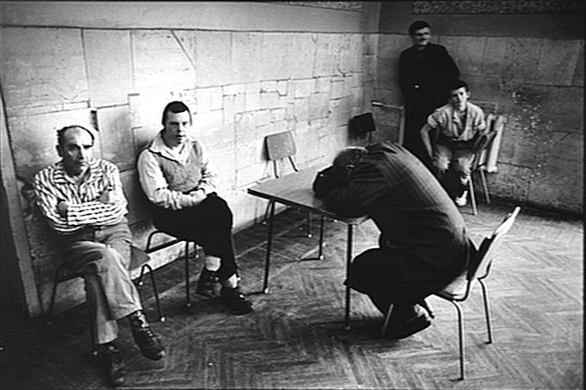
Notes:
Poor care and neglect is a feature of mental health institutions
Many people receive no form of stimulation, and spend days, months and even years living in excruciating boredom. watching TV.. With cig in there hand, sleeping a lot..
Some people are over-medicated so that they remain docile and 'easy to manage'.
This aimlessness, inactivity, and social isolation is inhuman and degrading and not conducive to recovery or good mental health.
Even when the mental health facility is clean , the toilets are in good shape the staff are 'nice and kind' .. neglect remains a main feature of institutional care.
Some institutions try to adopt some recreational activities but these are more akin to school arts and crafts activities (basket weaving, and painting then a real engagement in meaningful ADULT activities that will ultimately lead to integration into the community

Slide 26
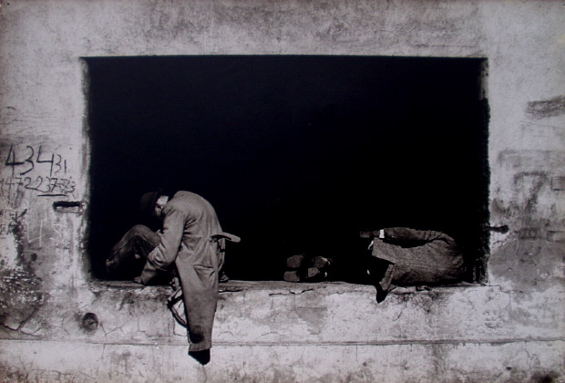

Slide 27
3.Human rights violations of people with mental disabilities
Violations in the mental health care context 3
Inappropriate admission and treatment
Unjustifiable hospitalizations for months and sometimes years
No informed consent
Assumption of incapacity resulting in removal of rights
Examples from Chile: involuntary admission, sterilization & psychosurgery
Notes:
Violations in the mental health care context
Other human rights violations that are associated with the health care context are that :
For example - Issues concerning consent for admission and treatment are ignored. People are unjustifiable and arbitrarily locked away for months and sometimes years at time. Psychiatric institutions in countries all over the world are full of people who simply should not be there.
Another issue is that there tends to be the presumption that a person with a mental disability is incapable of making decisions about his or her life and consequently they are stripped of their rights to make decisions concerning their treatment and care, to manage their financial and personal affairs etc. These matters are then left at the hands of a substitute decision maker or guardian despite the fact that the person may be perfectly able to make these decisions for him/herself.
Patients also lack access to legal processes and mechanisms to protect their rights despite the fact that they have been stripped of some of the fundamental human rights such as the right to liberty and autonomy.
Indeed many countries have no independent review mechanisms to systematically review cases of involuntary admission and treatment
In many countries there are no mechanisms for people to appeal against decisions to involuntarily admit or treat them.
Complaints mechanisms for reporting human rights violations are also missing in many countries throughout the world.

Slide 28
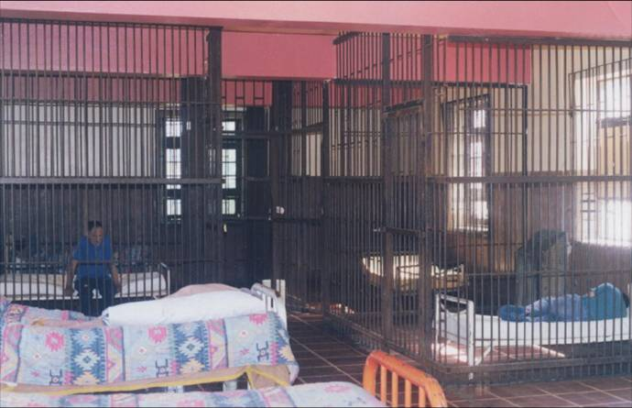
PSYCHIATRIC HOSPITAL EL PERAL, CHILE
(1990)

Slide 29
3.Human rights violations of people with mental disabilities
Violations in the mental health care context 4
Lack of access to legal processes
No independent review of involuntary admission and treatment
No appeals mechanisms
No complaints mechanisms
Absolute power of psychiatrists and other mental health professionals in mental hospitals
Notes:
Violations in the mental health care context
Other human rights violations that are associated with the health care context are that :
For example - Issues concerning consent for admission and treatment are ignored. People are unjustifiable and arbitrarily locked away for months and sometimes years at time. Psychiatric institutions in countries all over the world are full of people who simply should not be there.
Another issue is that there tends to be the presumption that a person with a mental disability is incapable of making decisions about his or her life and consequently they are stripped of their rights to make decisions concerning their treatment and care, to manage their financial and personal affairs etc. These matters are then left at the hands of a substitute decision maker or guardian despite the fact that the person may be perfectly able to make these decisions for him/herself.
Patients also lack access to legal processes and mechanisms to protect their rights despite the fact that they have been stripped of some of the fundamental human rights such as the right to liberty and autonomy.
Indeed many countries have no independent review mechanisms to systematically review cases of involuntary admission and treatment
In many countries there are no mechanisms for people to appeal against decisions to involuntarily admit or treat them.
Complaints mechanisms for reporting human rights violations are also missing in many countries throughout the world.

Slide 30
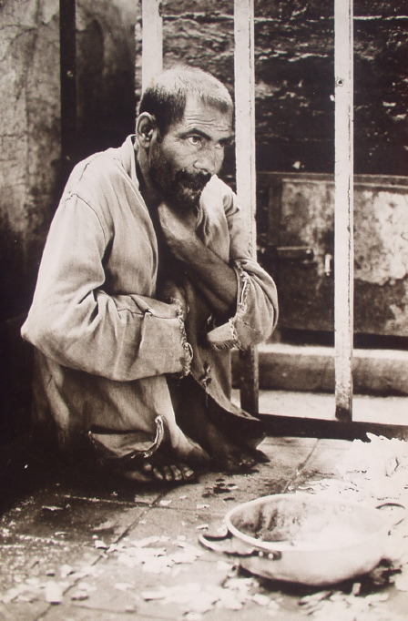
The El Peral Hospital (Santiago, Chile) became a warehouse of people with mental disorders and social problems

Slide 31
3. Human rights violations of people with
mental disabilities
Violations in the community context 1
People face violations in all areas of their lives:
Lack of employment opportunities
Discriminated while seeking a job
Dismissed because of mental illness
20% - 30% of people with severe mental disorder (schizophrenia) have a job in Europe
Lack of educational opportunities
Children with mental disabilities are institutionalized
They are segregated from “normal” children in special schools
Notes:
Violations in the community context
In addition to violations in psychiatric institutions, people with mental disabilities also face human rights violations in all areas of their lives in the community.
Many are discriminated against in seeking employment and others are dismissed from their jobs because of their mental illness. For example, in the majority of European countries where data are available, the employment rates of people with mental disabilities is between 20% and 30% and in the case of people with severe mental health problems like schizophrenia (the majority of whom are capable of and wish to work) employment rates are around 10% percent.( Kilian R, Becker T. “Macro-economic indicators and labour force participation of people with Schizophrenia” Journal of Mental Health. 2007; 16(2): 211-222. )
People with disabilities are also prone to being accepted only in second rate employment which offer repetitive work, low pay and bad conditions.
People with mental disabilities are also very often stripped of their right to education. For instance, in many eastern European countries, children with mental disabilities are institutionalized, and these institutions frequently fail to offer educational opportunities.
The institutionalization of children with mental disabilities and the subsequent violation of their right to education occurs in many places throughout the world. Tragically, in doing so, these countries incapacitate the children for the rest of their lives so that they are “destined to spend the whole of their life in an institution.
People with mental disabilities also face barriers to access to physical health care.
For example many spychiatric institutions don’t provide proper physical health care.
Also, very often when someone is diagnosed with a mental illness people tend to put physical issues and ailments of the person down to the mental disorder - so the focus of the treatment and care is always on the mental health aspect and the physical aspect gets ignored.
For example, a report in the UK by the Disability Rights Commission found that People with serious mental illness were less likely to get standard checks and treatments, and consequently were more likely to get deadly diseases, to get them younger, and to die of them within 5 years. The report also stated that people with severe mental illness died on average 10 years younger than the general population.
People with mental disabilities experience limitations in their right to exercise civil and political rights.
People with mental disabilities are also deprived of the right to form families. For instance, in certain places, persons placed under guardianship are not permitted to marry. In Bulgaria, they may not adopt or foster children. In the Russia, they may not file for divorce. In Albania, it is illegal for a person with a mental disability to marry regardless of their current mental state
Many countries, including Cameroon, Bermuda, Botswana, Thailand, Turkmenistan and Tanzania deny persons of “unsound mind” the right to vote.
In other countries, like Gibraltar, persons with mental disabilities cannot run for office (eg. Gibraltar).
In addition, in certain countries, even in places where people with mental disabilities are legally allowed to vote, de facto they are not permitted to do so due to their placement in institutions without access to polls (eg. bulgaria).
People with mental disabilities are even denied the right to associate. For instance, in Russia they cannot form or belong to political organizations. In Bulgaria, adults under guardianship cannot found or join non-profit organizations or cooperatives.
People all over the world are also denied the opportunity to participate in decision making processes (eg. design and implementation of policies, laws, services) on issues that affect them
The denial of these basic human rights means that people with mental disabilities are essentially prevented from fully integrating into society, engaging in social, economic and political life and consequently, from living meaningful and fulfilling lives in the community.

Slide 32
3. Human rights violations of people with mental disabilities
Violations in the community context
Violation of civil rights
Right to vote,
To marry
To have children or to adopt one
To a fair trial (inappropriately detained in prisons)
To engage in financial transactions
People with mental disabilities are prevented from integrating into society
Notes:
Violations in the community context
In addition to violations in psychiatric institutions, people with mental disabilities also face human rights violations in all areas of their lives in the community.
Many are discriminated against in seeking employment and others are dismissed from their jobs because of their mental illness. For example, in the majority of European countries where data are available, the employment rates of people with mental disabilities is between 20% and 30% and in the case of people with severe mental health problems like schizophrenia (the majority of whom are capable of and wish to work) employment rates are around 10% percent.( Kilian R, Becker T. “Macro-economic indicators and labour force participation of people with Schizophrenia” Journal of Mental Health. 2007; 16(2): 211-222. )
People with disabilities are also prone to being accepted only in second rate employment which offer repetitive work, low pay and bad conditions.
People with mental disabilities are also very often stripped of their right to education. For instance, in many eastern European countries, children with mental disabilities are institutionalized, and these institutions frequently fail to offer educational opportunities.
The institutionalization of children with mental disabilities and the subsequent violation of their right to education occurs in many places throughout the world. Tragically, in doing so, these countries incapacitate the children for the rest of their lives so that they are “destined to spend the whole of their life in an institution.
People with mental disabilities also face barriers to access to physical health care.
For example many spychiatric institutions don’t provide proper physical health care.
Also, very often when someone is diagnosed with a mental illness people tend to put physical issues and ailments of the person down to the mental disorder - so the focus of the treatment and care is always on the mental health aspect and the physical aspect gets ignored.
For example, a report in the UK by the Disability Rights Commission found that People with serious mental illness were less likely to get standard checks and treatments, and consequently were more likely to get deadly diseases, to get them younger, and to die of them within 5 years. The report also stated that people with severe mental illness died on average 10 years younger than the general population.
People with mental disabilities experience limitations in their right to exercise civil and political rights.
People with mental disabilities are also deprived of the right to form families. For instance, in certain places, persons placed under guardianship are not permitted to marry. In Bulgaria, they may not adopt or foster children. In the Russia, they may not file for divorce. In Albania, it is illegal for a person with a mental disability to marry regardless of their current mental state
Many countries, including Cameroon, Bermuda, Botswana, Thailand, Turkmenistan and Tanzania deny persons of “unsound mind” the right to vote.
In other countries, like Gibraltar, persons with mental disabilities cannot run for office (eg. Gibraltar).
In addition, in certain countries, even in places where people with mental disabilities are legally allowed to vote, de facto they are not permitted to do so due to their placement in institutions without access to polls (eg. bulgaria).
People with mental disabilities are even denied the right to associate. For instance, in Russia they cannot form or belong to political organizations. In Bulgaria, adults under guardianship cannot found or join non-profit organizations or cooperatives.
People all over the world are also denied the opportunity to participate in decision making processes (eg. design and implementation of policies, laws, services) on issues that affect them
The denial of these basic human rights means that people with mental disabilities are essentially prevented from fully integrating into society, engaging in social, economic and political life and consequently, from living meaningful and fulfilling lives in the community.

Slide 33
Human rights violations of people with mental and psychosocial disabilities: an unresolved global crisis
Natalie Drew, Michelle Funk, Stephen Tang, Jagannath Lamichhane, Elena Chávez, Sylvester Katontoka, Soumitra Pathare, Oliver Lewis, Lawrence Gostin, Benedetto Saraceno
Experience of 51 people with mental and psychosocial disabilities from 18 low-income and middle-income countries as well as a review of English language literature
Lancet 2011; 378: 1664–75. Published Online October 17, 2011
DOI:10.1016/S0140-6736(11)61458-X

Slide 34
Panel 3: Most common human rights
violations as described by respondents,
sorted by descending frequency
• Exclusion, marginalisation, and discrimination in the community
• Denial or restriction of employment rights and opportunities
• Physical abuse/violence
• Inability to access effective mental health services
• Sexual abuse/violence
• Arbitrary detention
• Denial of opportunities for marriage/right to found a family
• Lack of means to enable people to live independently in the community
• Denial of access to general health/medical services
• Financial exploitation

Slide 35
Panel 4: Environments in which human rights violations are most likely to take place, as described by respondents,
sorted by descending frequency
• General community settings in everyday life
• Home and family settings
• The workplace or potential workplace
• Psychiatric institutions and mental health services
• Hospitals and health-care services
• Prisons, police, and the legal system
• Government and official services
• Schools and the education sector

Slide 36

WHO QualityRights Project
Act, Unite & Empower for Mental Health

Slide 37
Establishes key standards to be met in all inpatient and outpatient facilities
Safe and hygienic living conditions and a social environment conducive to recovery
Evidence based care for mental and physical health problems based on consent
Facilities that enhance autonomy and engage people in their own recovery
Facilities that document, report and prevent inhuman treatment practices
Facilities that support people to access employment, education, social and housing services so they can live independent lives in the community

Slide 38

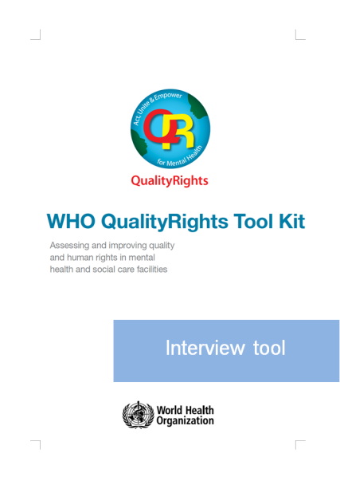
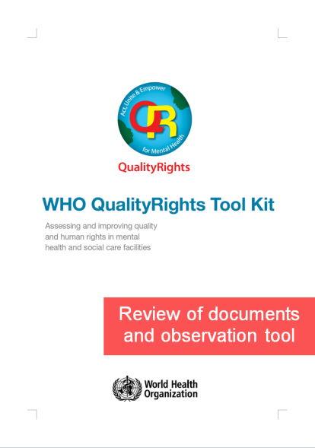
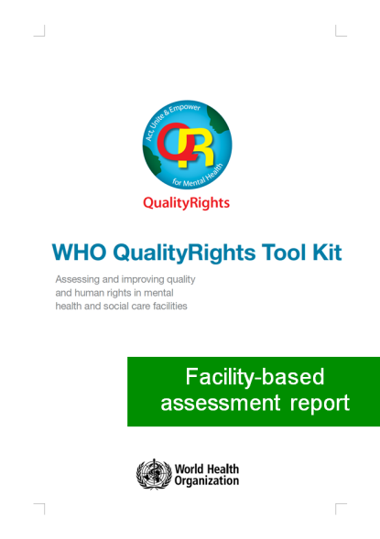
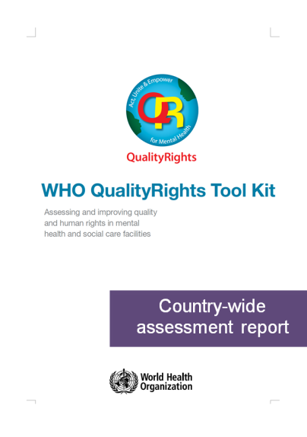
Practical information and guidance on:
How to conduct a comprehensive assessment
How to report the findings of the assessment
How to use the results and recommendations to improve quality of care and human rights

Slide 39
Diploma Project:
Aikaterini Nomidou, (2013)
"Standards in mental health facilities - an in depth case study in Greece using the WHO QualityRights tool"
Journal of Public Mental Health, Vol. 12 Iss: 4

Slide 40
The most significant and innovative of the new norms articulated in the CRPD, that of legal capacity, is not recognized or supported for patients in the Psychiatric Clinic.
Findings from the Clinic revealed that the capacity to make healthcare decisions and personal life decisions was either unrecognized or unsupported.
People with psychosocial disabilities have an equal right to liberty. Findings from the review of the medical files for 19 involuntary patients indicate that they are deprived of liberties such as the right to live in freedom and security without compulsory medical interventions, which is in contrast with patients at the Urology Clinic.

Slide 41


QualityRights evaluation of a representative sample of outpatient facilities in Chile

Slide 42
1: Evaluation of the level of quality care and human rights respect in 15 specialized MH outpatients facilities

Slide 43
Total percentage of achievement (maximum, media and minimum) and by QR themes

Slide 44
Level of achievement for right to physical and mental health (maximum, media and minimum) by standards

Slide 45
Level of achievement for right to legal capacity & liberty (maximum, media and minimum) by standards

Slide 46
2: Evaluation of the association between level of achievement in qualityrights in outpatient facilities and adherence to treatment in people with first episode Schizophrenia

Slide 47
Association between 4 outpatient themes of QualityRights and adherence in people with first episode schizophrenia

Slide 48
Association between standards for right to health and adherence in people with first episode schizophrenia(*p-value<0,05)

Slide 49
Association between standards for right to community inclusion and adherence in people with first episode schizophrenia(*p-value<0,05)

Slide 50
3. users’ opinions of qualityrights achievement in mental health outpatients facilities

Slide 51
Comparison of users’ opinions with families and staff’s opinion (*p-value<0,05). QualityRights evaluation of outpatient facilities in Chile

Slide 52
CONCLUSIONS
Mental health policy, laws & local practice can affect human rights of persons with mental disorders in different ways
Human rights violations affect mental health of the general population
Human rights violations of people with mental disabilities happen worldwide in institutions and in the community
WHO QualityRights is a useful tool to know how MH facilities are dealing with user’s human rights and to promote changes according to CRPD

Slide 53
Thank you!

