Slide 2
Content of Mental Health Legislation

Slide 3
Single Law vs Multiple Laws
Single Law – all issues related to mental disorders eg health, employment, housing etc
Multiple Laws – provisions distributed in relevant legislation eg. Employment issues in general employment legislation
Single Disability Law – covering all persons with disability incl persons with mental disorders
Multiple disability laws – according to requirements of various disability groups eg persons with physical disability, mental disability

Slide 4
Access to Mental Health Care
Has most impact on rights protection
Article 25 of CRPD
Provide persons with disabilities with the same range, quality and standard of free or affordable health care and programmes as provided to other persons

Slide 5
Access to Mental Health Care
Integration
Prevention, Promotion, Treatment & Rehabilitation
Access barriers
Availability
Financial and Geographical accessibility
Quality

Slide 6
Access to Mental Health Care
Example from Mental Health Care Bill (India)

Slide 7
18. (1) Every person shall have a right to access mental health care and treatment
from mental health services run or funded by the appropriate Government.
(2) The right to access mental health care and treatment shall mean mental health services of affordable cost, of good quality, available in sufficient quantity, accessible geographically, without discrimination on the basis of gender, sex, sexual orientation, religion, culture, caste, social or political beliefs, class, disability or any other basis and provided in a manner that is acceptable to persons with mental illness and their families and care-givers.
(3) The appropriate Government shall make sufficient provision as may be necessary, for a range of services required by persons with mental illness.

Slide 8
(4) Without prejudice to the generality of range of services under sub-section (3), such services shall include––
(a) provision of acute mental health care services such as outpatient and inpatient services;
(b) provision of half-way homes, sheltered accommodation, supported accommodation;
(c) provision for mental health services to support family of person with mental illness or home based rehabilitation;
(d) hospital and community based rehabilitation establishments and services;
(e) provision for child mental health services and old age mental health services.
(5) The appropriate Government shall,—
(a) integrate mental health services into general health care services at all levels of health care including primary, secondary and tertiary health care and in all health programmes run by the appropriate Government;
(b) provide treatment in a manner, which supports persons with mental illness to live in the community and with their families;
(c) ensure that the long term care in a mental health establishment for treatment of mental illness shall be used only in exceptional circumstances, for as short a duration as possible, and only as a last resort when appropriate community based treatment has been tried and shown to have failed;
(d) ensure that no person with mental illness (including children and older persons) shall be required to travel long distances to access mental health services and such services shall be available close to a place where a person with mental illness resides;
(e) ensure that as a minimum, mental health services run or funded by Government shall be available in each district;
(f) ensure, if minimum mental health services specified under sub-clause (e) of sub-section (4) are not available in the district where a person with mental illness resides, that the person with mental illness is entitled to access any other mental health service in the district and the costs of treatment at such establishments in that district will be borne by the appropriate Government:
Provided that till such time the services under this sub-section are made available in a health establishment run or funded by the appropriate Government, the appropriate Government shall make rules regarding reimbursement of costs of treatment at such mental health establishment.

Slide 9
(10) Without prejudice to the generality of range of services under sub-section (3) of section 18, the appropriate Government shall notify Essential Drug List and all medicines on the Essential Drug List shall be made available free of cost to all persons with mental illness at all times at health establishments run or funded by the appropriate Government starting from Community Health Centres and upwards in the public health system:
Provided that where the health professional of ayurveda, yoga, unani, siddha, homoeopathy or naturopathy systems recognised by the Central Government are available in any health establishment, the essential medicines from any similar list relating to the appropriate ayurvada, yoga, unani, siddha, homoeopathy or naturopathy systems shall also be made available free of cost to all persons with mental illness.

Slide 10
Article 25 of CRPD :
“Require health professionals to provide care of the same quality to persons with disabilities as to others, including on the basis of free and informed consent by, inter alia, raising awareness of the human rights, dignity, autonomy and needs of persons with disabilities through training and the promulgation of ethical standards for public and private health care”
Legislation can do a lot to Promote Voluntary Care

Slide 11
Article 19 Right to live in the community
Requires
Adequate community facilities
Support families and care-givers
Support to living in the family
REQUIRES THAT CHOICES ARE PROVIDED

Slide 12
19. (1) Every person with mental illness shall,––
have a right to live in, be part of and not be segregated from society; and
(b) not continue to remain in a mental health establishment merely because he does not have a family or is not accepted by his family or is homeless or due to absence of community based facilities.
(2) The appropriate Government shall, within a reasonable period, provide for or support the establishment of less restrictive community based establishments including halfway homes, group homes and the like for persons who no longer require treatment in more restrictive mental health establishments such as long stay mental hospitals.

Slide 13
Promote Voluntary Care
Stating that outpatient voluntary Rx is the norm
Stating explicitly that voluntary admission is the norm
Ensuring privacy
Stating that consent can be withdrawn at any time

Slide 14
Consent
Criteria for valid consent
a) The person/patient giving consent must have capacity to do so, and capacity is assumed unless there is evidence to the contrary.
b) Consent must be obtained freely, without threats or improper inducements.
c) There should be appropriate and adequate disclosure of information. Information must be provided on the purpose, method, likely duration and expected benefits of the proposed treatment.
d) Possible pain or discomfort and risks of the proposed treatment, and likely side-effects, should be adequately discussed with the patient.
e) Choices should be offered, if available, in accordance with good clinical practice; alternative modes of treatment, especially those that are less intrusive, should be discussed and offered to the patient.

Slide 15
Consent
f) Information should be provided in a language and form that is understandable to the patient
g) The patient should have the right to refuse or stop treatment
h) Consequences of refusing treatment, which may include discharge from the hospital, should be explained to the person
i) The consent should be documented in the patient's medical records
k) the Right to Consent also means the right to refuse

Slide 16
Promoting Voluntary Care
Advance Directives
Representation Agreements
Enduring Powers of attorney

Slide 17
Incapacity
Traditionally incapacity is based on three different categories
Status approach : presumes that a person with a specific type of disability (schizophrenia) lacks legal capacity
Outcomes approach: based on evaluations (right/wrong) of the decision made
Functional approach: based on a person's ability to perform a specific function, say for example understand a contract

Slide 18
Mental Capacity
Mental capacity
Understand the information relevant to the decision
Retain the information
Use the information as part of decision making process
Communicate the decision by any means

Slide 19
Mental Capacity = Legal Capacity
Or
Mental Incapacity = Legal Incapacity

Slide 20
Legal Capacity as in CRPD
Functional approach (mental capacity) still means that legal capacity is attached to the attributes of the person
On the other hand, in the CRPD legal capacity is a social or legal status which is independent of the persons ability or attributes

Slide 21
Legal Capcity and CRPD
CRPD
Legal capacity does not reflect a person's ability to make decisions
Right to make decisions and have those respected

Slide 22
Decision making Capability- Bach
Focus on ability rather than disability
Decision making capability = ability (mental capacity) + support + accommodations
Translates well into the CRPD's focus on supported decision making
Recognizes that human beings are not always making 'in-dependent' decisions but rather are 'inter-dependent' on significant others

Slide 23
Decision Making Status
Legally independent decision making status
Supported decision making status
Facilitated decision making status
Legal Capacity is not removed – but person can make decisions through any of the above status

Slide 24
Independent decision making
Ability by himself or with assistance to understand information relevant to making a decision
Ability by himself or with assistance to appreciate reasonably foreseen consequences of the decision

Slide 25
Supported Decision making status
Person acts in a way such that at least one other person (supporter) who has personal knowledge of the person can
Ascribe to the persons actions, personal intent and will consistent with the person's identity
Take consequential actions to give effect to that will and/or intentions of the individual

Slide 26
How should the supporter act?
Consult with the individual to ascertain current wishes
Bound by the persons wishes expressed in a prior planning document and applicable to the current situation
Be guided by any wishes/instructions expressed in the past and may be applicable in the current situation
Be guided by the wishes expressed in current situation

Slide 27
How should the supporter act?
Use reasonable diligence to ascertain the person's wishes and instructions
Comply with the person's wishes and instructions that respects their dignity of risk
Greater or lesser discretion in translating a person's will into action – depending on how much will has been expressed and taking into account best interests of the person

Slide 28
How is this different from substituted decision making ?
Substitute decision makers not bound to comply with the person's wishes
Supported decision makers are bound to comply with the person's wishes

Slide 29
Facilitated Decision making status
Others facilitate the making of decisions based on
best interest principle
This would apply to
Those who are not legally independent or those who do not have a significant other who can understand their will/intentions
Individuals who have indicated as such in a prior planning document
There are significant others who know them well and are committed to acting for them, but are unable discern the person's current will or intentions to guide decision making

Slide 30
Facilitated Decision making status
Does not mean that the person does not have capacity to make decisions
“Others are not able to discern a person's will and/or intentions sufficiently to assist its translation into decisions”

Slide 31
How is a facilitator appointed ?
Prior planning document – e.g. POA, advance directive
By an administrative Tribunal

Slide 32
Best interest principle
Based on person's prior wishes, values, life history
Improve the quality of person's life
Prevent the quality of person's life from deteriorating
Reduce the extent to which or rate at which a person's quality of life will deteriorate
Decisions that outweigh the risk of harm

Slide 33
Apply to one area, some areas or all areas of life
No loss of legal capacity
Temporary state
Can move up/down the decision making status over time and for different decisions

Slide 34
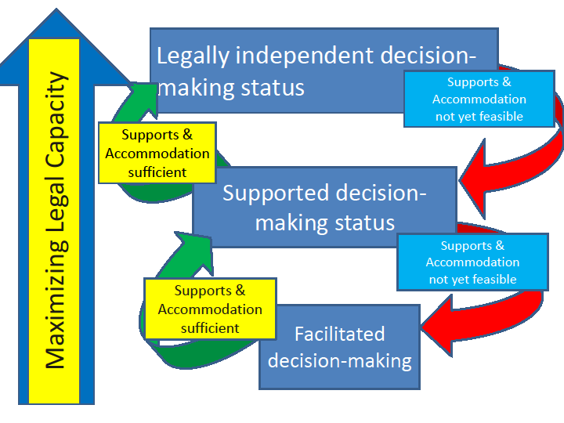

Slide 35
Shifts the focus away from the capacity and competency of the individual to competency of the decision making process
Shifts the focus away from removal of legal capacity when the person does not have mental capacity to a system where support and accommodation evolves with time

Slide 36
Accommodation
Legal duty to take positive action to accommodate the unique needs of persons with disabilities
Not unlimited – to the point of undue hardship

Slide 37
Safeguards
Safeguarding the integrity of decision making process
Safeguards to ensure decision making status is recognized
Safeguards where decisions affect personal integrity
Safeguards against serious adverse effects, including neglect and abuse

Slide 38
Serious Adverse Events
A situation due to a person's actions or those of others
Failure to provide necessities of life for himself or dependents
Experiences serious illness or injury and deprivation of personal liberty or security
Has threatened or attempted (or threating or attempting) to cause physical or psychological harm to himself or herself
Has behaved or is behaving violently towards another person or is causing the other to fear physical or psychological harm

Slide 39
SAE & Decision making status
SAE & Independent decision making status = no involuntary commitment to psychiatric facility
SAE & Supported decision making status = no involuntary commitment to psychiatric facility
SAE & Facilitated decision making status = facilitator can seek admission to a psychiatric facility

Slide 40
SAE & Facilitated Status
Physician cannot admit – facilitator can
Provision of appeal – if the individual resists admission (protesting patient)

Slide 41

Least restrictive
“Every patient shall have the right to be treated in the least restrictive environment and with the least restrictive or intrusive treatment appropriate to the patient’s health needs and the need to protect the physical safety of others.” (Principle 9(1), MI Principles)

Slide 42
Promoting autonomy - tools
Advance Directives
Representation Agreements
Enduring Power of Attorney

Slide 43
And Lastly....
“Dignity of Risk”

Slide 44
Discrimination in Health Care
Discrimination in general health care
Discrimination in provision of mental health care
Discrimination in provision of health insurance

Slide 45
Right to Information
Access to medical records
To whom
Person with mental illness
To their nominee/supporter
To Family ?

Slide 46
Confidentiality
Of mental health care & medical information
In media

Slide 47
Protection from Torture, Cruel, inhuman and degrading & inhuman treatment
May not be required if general legislation covers it
However useful to restate it in the law again for mental health

Slide 48
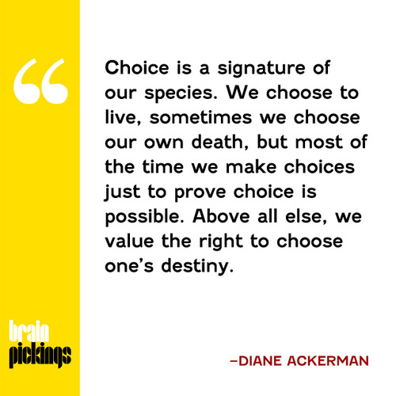
CHOICE !

