Slide 1
Organization of services for mental health
Melvyn Freeman

Slide 2
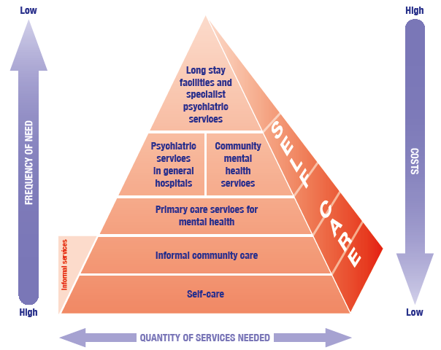
WHO PYRAMID OF CARE

Slide 3
Mental Hospitals
Poor access
Result in human rights violations
Poor mental health and physical health outcomes
Consume nearly all mental health funds and resources

Slide 4
Mental health units in General Hospitals
Improved access
Management of acute illness episodes
Treatment provided for co-morbid physical health problems
Teaching and training possible for a wide group of health workers

Slide 5
Build Community MHS
Can prevent hospitalisation
Good health, mental health and quality of life outcomes
Reduced risk of descending into poverty

Slide 6
Mental health services in Primary Care
Dramatic improvement in access
Reduces stigma
Holistic care
Good are and treatment outcomes
Affordable and cost effective
Addresses human resource shortages
Reduces human rights violations

Slide 7
Informal Community MHS
Widespread access to supports
Integration and acceptance in the community
Improved recovery and reduced risk of relapse
Reduced stigma and human rights violations
Stronger advocacy and lobbying

Slide 8
Self care
Substantially reduce access problems
Reduce the pressure on the health care system
Reduce stigma
Promote mental health

Slide 9
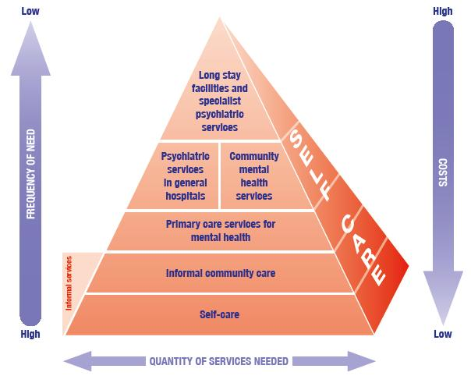
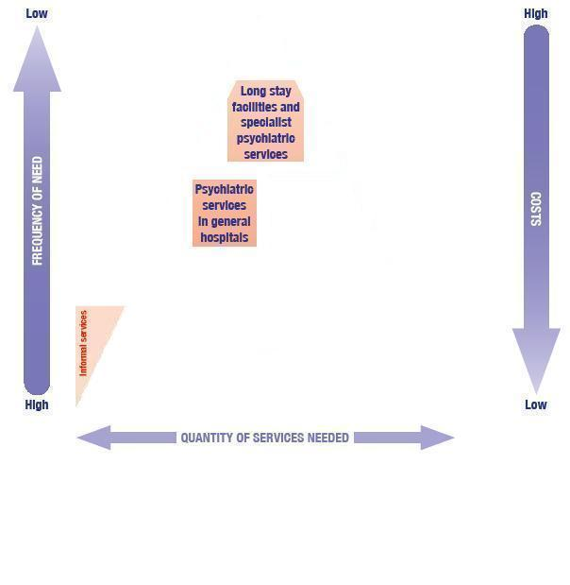
Current status of service organization

Slide 10
 |  | Hospitals designated psychiatric hospitals and or care and Rehab centres
 | Total Hospitals | Total desig | District Hospitals | Regional | Tertiary | Central | Specialized
Eastern Cape | 63 | 8 | 2 (42) | 2(3) | 0(3) | 0(1) | 4
Gauteng | 33 | 13 | 1(11) | 2(8) | 2(3) | 4(4) | 3
Free State | 25 | 3 | 0(15) | 2(4) | 0(2) | 0 | 1
KZN | 72 | 11 | 0(37) | 3(19) | 1(2) | 0(1) | 1
Limpopo | 40 | 12 | 6(30) | 2(5) | 1(2) | 0 | 3
Mpumalanga | 29 | 3 | 0(19) | 0(3) | 2(2) | 0 | 0
Northern Cape | 14 | 1 | 0(11) | 0(1) | 1(1) | 0 | 1
North West | 19 | 4 | 1(12) | 0(3) | 1(2) | 0 | 2
Western Cape | 41 | 9 | 0(20) | 1(3) | 0(3) | 2(2) | 1
TOTAL | 336 | 64 | 10(197) | 12(49) | 8(20) | 6(8) | 16
 |  | 19% | 5% | 24% | 40% | 75%

Slide 11
 | 72 hr assessment facilities in provinces
 | Total Hospitals | Total listed | District Hospitals listed | Regional listed | Tertiary listed | Central listed
Eastern Cape | 63 | 34 | 26 (42) | 2(3) | 1(3) | 1(1)
Gauteng | 33 | 26 | 9(11) | 7(8) | 3(3) | 4(4)
Free State | 25 | 16 | 11(15) | 3(4) | 1 | 0
KZN | 72 | 48 | 35(37) | 10(19) | 1(14) | 1(1)
Limpopo | 40 | 34 | 25(30) | 5(5) | 1(2) | 0
Mpumalanga | 29 | 22 | 9(19) | 3(3) | 0 | 0
Northern Cape | 14 | 6 | 3(11) | 1(1) | 1(1) | 0
North West | 19 | 4 | 1(12) | 0(3) | 1(2) | 0
Western Cape | 41 | 16 | 14(20) | 1(3) | 0(3) | 0(2)
 | 336 | 206 | 133(197) | 32(49) | 9(20) | 5 (8)
 |  | 61% | 68% | 65% | 45% | 63%

Slide 12
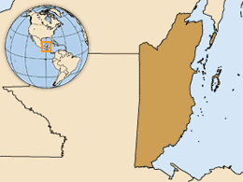
Psychiatric services in general hospitals: Belize
Before 1990 1 psychiatric hospital: 1 outpatient clinic
Training of psychiatric nurse practitioners and placement of two in 7 /8 district hospitals
Psychiatric nurse practitioners conduct outpatient clinics; mobile clinics and home visits
2nd stage is to train primary care practitioners
➡ Reduced number of psychiatric hospitalizations ; 180 - 50 - 0
➡ Increased access to outpatient and community-based mental health services 1,000 -14 000
Notes:
World Health Organization
2 November 2012
12

Slide 13
Community-based care: CMHT
Community Mental Health outreach services by multi-disciplinary team
2010 Cochrane review of CMHT found 3 studies
Study 1 (Burns 1993):
No differences in clinical or social outcomes, both showing improvement
Access to care 93% in CMHT vs. 75% in control group
Three suicides in control vs. one in CMHT group
Study 2 (Tyrer 1998):
Similar clinical outcomes
Costs of care 14% less in CMHT group due to lessened admissions
Study 3 (Merson 1992):
Improvement in symptoms
More satisfied with services
Eight times less days spent in psychiatric inpatient services

Slide 14
Community-based care: Early intervention
For adolescents and adults experiencing a first episode of mental illness to support recovery and integration into education, employment, social networks
Multidisciplinary teams
Consist of:
Early detection and assessment
Making joint decisions about medication
Coordinated care
Psychosocial interventions
Support for education and employment
Acute care in the home
Important for severe mental illnesses such as psychosis
First three years critical for course of illness and recovery

Slide 15
Community-based care: Early intervention
Cochrane Review 2011
18 Randomised studies from Australia, Europe, UK, US and China.
Key Findings of the Review
Treatment in specialised early intervention services may delay the onset of psychosis
Treatment in these specialised services is more acceptable to patients
Family therapy may prevent relapse
Vocational interventions provide higher rates of employment

Slide 16
Community-based care: Supported housing
Supported housing programmes provide accommodation linked with clinical and psychosocial services
Range of levels of psychiatric disability
The New South Wales Housing and Support Initiative (HASI)
Services 100 people with high levels of psychiatric disabilities
Designed to assist people to:
Participate in the community
Maintain successful tenancies
Improve quality of life
Assist in recovery from illness
Partnership between NSW Health, Dept of Housing and NGOs
Psychosocial rehabilitation principles with a recovery focus
Provides permanent, long-term accommodation, support for community participation and mental health care

Slide 17
Community-based care: Supported housing
HASI evaluation:
Included 633 interview and surveys with a range of stakeholders
Significant outcomes for tenants:
68% reporting improvement in psychological symptoms
84% of participants experienced reduced rates, frequency and duration of hospitalisation
81% reduction in time spent in emergency departments
Increase in community participation: 94% of participants reported establishing friendships through the program, 73% participating in social and community activities, and 43% studying or working
Over 50% reported regular access to health care, better diet and increased exercise
81% of participants said they were satisfied or more than satisfied with their family relationships since participating in the HASI program.
Overall high retention rates but those more likely to leave were recently released from prison, had children, or Indigenous Australians
Results now being used to develop the next stage of the project

Slide 18
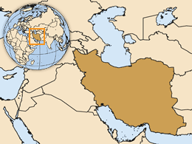
IRAN - Nationwide integration of mental health into primary care
Community health workers (behvarzes) responsible for active case finding and referral
General practitioners have mental health care as part of their general health responsibilities in urban and rural health centers
Specialists based in district or provincial health centre for complex cases
➡ A significant proportion of the population is covered by accessible, affordable and acceptable mental health care
Notes:
World Health Organization
2 November 2012
18

Slide 19
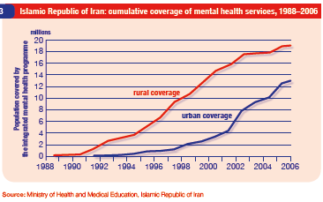
Evaluation & Outcomes
Iran
By 2006, 82% of the rural population and 29% of the urban population covered
Changed community attitudes;
Changes in mental health care seeking patterns, from traditional healers to primary care
Evidence-based interventions for psychosis, mental retardation, and epilepsy are implemented
Notes:
World Health Organization
2 November 2012
19

Slide 20
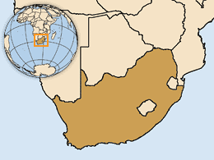
SOUTH AFRICA - Integrated primary care services, Ehlaneni district, Mpumalanga Province
2 different service models in the same district
Model 1 based on a skilled professional nurse
Model 2 involving all primary care workers
➡2000 – 2007
From none to 83% of primary care clinics providing mental health services after 10 years of integration
Notes:
World Health Organization
2 November 2012
20

Slide 21
Informal community care: peer support
Based on the premise that people with mental illness can better relate and empathise with others in a similar situtation
Focus on a strengths-based, recovery approach
Provide an opportunity for giving and receiving support, sharing personal experiences, and creating mutual understanding that is beneficial to both individuals
Several types of peer support, including informal support and advocacy groups
Little research on the outcomes of informal peer support groups but evaluations that have been done show:
Reduced hospital stays
Reduced criminal activity
Closer friendships and support networks

Slide 22
Self-care
Self-care or is the use of programmes to help service users to learn techniques to manage their illness independently, plan their recovery and prevent relapse
Illness management and recovery (IMR) developed by SAMHSA
Evidence-based
Integrates components of recovery with strategies to help service users to collaborate with mental health professionals, cope with their illness, and pursue their own personal goals.
Recent retrospective cohort study (Salyers et al 2011)
5 community treatment teams
498 service users
Those who received IMR in conjunction with assertive community treatment had fewer hospitalisation days and fewer emergency room visits

Slide 23













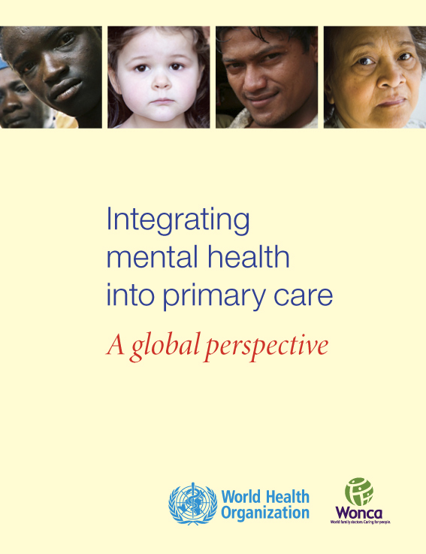

WHO Supporting Resources
WHO Mental Health Policy and Service Guidance Package
WHO Report on Integrating Mental Health into Primary Care
WHO Resource Book on Mental Health, Human Rights and Legislation
Training materials and tools

