Slide 1
South Africa Experience of Mental Health Legislation: Success and Failures
Melvyn Freeman
Chief Director: Non-communicable Diseases
National Department of Health
South Africa

Slide 2
Objectives of the Mental Health Care Act 2002
Regulate mental health care in a manner that-
Makes the best possible mental health care, treatment and rehabilitation services available to the population equitably, efficiently and in the best interest of mental health care users within the available resources
Co-ordinates access to mental health care treatment and rehabilitation services to various categories of mental health care users and
Integrates the provision of mental health care services into the general health services environment.

Slide 3
Regulate access to and provide mental health care treatment and rehabilitation services to:-
Voluntary, assisted and involuntary mental health care users
State patients and
Mentally ill prisoners
Clarify the rights and obligations of mental health care users and the obligations of mental health care providers and
Regulate property issues.

Slide 4
Changes from old Mental Health Act
1)Change in name to Mental Health Care Act
2)Section on Rights of people with Mental Disorders
3)Introduction of Review Boards and taking away the role of magistrates
4)Introduction of Mental Health Practitioner category
5)Integration of mental health into general health care – including at primary and secondary levels

Slide 5
Changes from old Mental health Act
6)Introduction of 72 hour assessment for involuntary users
7)Periodic reviews for involuntary users and State patients made shorter
8)Introduction of involuntary community care
9)Voluntary users to be treated in the same manner as physical health users
10)Promotes the provision of community care.
11)Mental health services must be provided according to standards applicable to any other health care user

Slide 6
Is mental health care now available, accessible and affordable?
No! But there have been major progress made since the introduction of the legislation.
There has been major progress in including mental health into the general health service environment, especially in hospitals.
Introduction of a 72 hour assessment period in general hospitals.
Whereas prior to the legislation almost all mental health care happened in large, inaccessible psychiatric hospitals now…..

Slide 7
 |  | Hospitals designated psychiatric hospitals and or care and Rehab centres
 | Total Hospitals | Total desig | District Hospitals | Regional | Tertiary | Central | Specialized
Eastern Cape | 63 | 8 | 2 (42) | 2(3) | 0(3) | 0(1) | 4
Gauteng | 33 | 13 | 1(11) | 2(8) | 2(3) | 4(4) | 3
Free State | 25 | 3 | 0(15) | 2(4) | 0(2) | 0 | 1
KZN | 72 | 11 | 0(37) | 3(19) | 1(2) | 0(1) | 1
Limpopo | 40 | 12 | 6(30) | 2(5) | 1(2) | 0 | 3
Mpumalanga | 29 | 3 | 0(19) | 0(3) | 2(2) | 0 | 0
Northern Cape | 14 | 1 | 0(11) | 0(1) | 1(1) | 0 | 1
North West | 19 | 4 | 1(12) | 0(3) | 1(2) | 0 | 2
Western Cape | 41 | 9 | 0(20) | 1(3) | 0(3) | 2(2) | 1
TOTAL | 336 | 64 | 10(197) | 12(49) | 8(20) | 6(8) | 16
 |  | 19% | 5% | 24% | 40% | 75%

Slide 8
 | 72 hr assessment facilities in provinces
 | Total Hospitals | Total listed | District Hospitals listed | Regional listed | Tertiary listed | Central listed
Eastern Cape | 63 | 34 | 26 (42) | 2(3) | 1(3) | 1(1)
Gauteng | 33 | 26 | 9(11) | 7(8) | 3(3) | 4(4)
Free State | 25 | 16 | 11(15) | 3(4) | 1 | 0
KZN | 72 | 48 | 35(37) | 10(19) | 1(14) | 1(1)
Limpopo | 40 | 34 | 25(30) | 5(5) | 1(2) | 0
Mpumalanga | 29 | 22 | 9(19) | 3(3) | 0 | 0
Northern Cape | 14 | 6 | 3(11) | 1(1) | 1(1) | 0
North West | 19 | 4 | 1(12) | 0(3) | 1(2) | 0
Western Cape | 41 | 16 | 14(20) | 1(3) | 0(3) | 0(2)
 | 336 | 206 | 133(197) | 32(49) | 9(20) | 5 (8)
 |  | 61% | 68% | 65% | 45% | 63%

Slide 9
Primary health care services
There is progress being made with providing mental health care in primary care.
This involves various models including
Full integration into primary care as part of chronic health care delivery with referral either to a hospital or skilled community mental health nurse in the clinic.
Mental health care done by community mental health nurses in community clinics.
State mental health services, including ongoing medication is free.
Assessments for involuntary/assisted care done in primary care.

Slide 10
Is decentralised care effective
Yes, but….

Slide 11
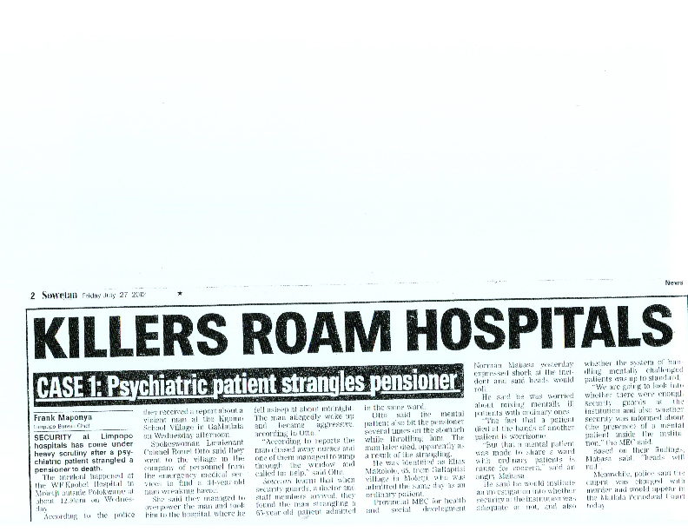

Slide 12
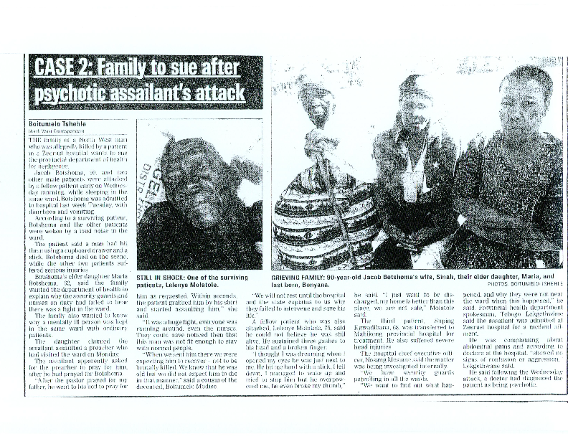

Slide 13
The legislation has a whole section on human rights but is this protecting human rights in and outside of health care settings?
Yes and no …

Slide 14
"At Fort Napier Hospital in KwaZulu-Natal, a committee was appointed to investigate the allegations of abuse. The committee identified 10 system defects which included the confirmation of gross human rights violations such as physical and sexual abuse of patients by staff. Disciplinary measures were taken and matters relating to criminal justice system were referred to the SAPS.
The Libode Mental Health facility, attached to St Barnabas Hospital in the Eastern Cape was closed down because of poor conditions and lack of compliance.
Some sections of the mental health unit at George Mukhari Hospital in Garankuwa were shut down.

Slide 15


Slide 16
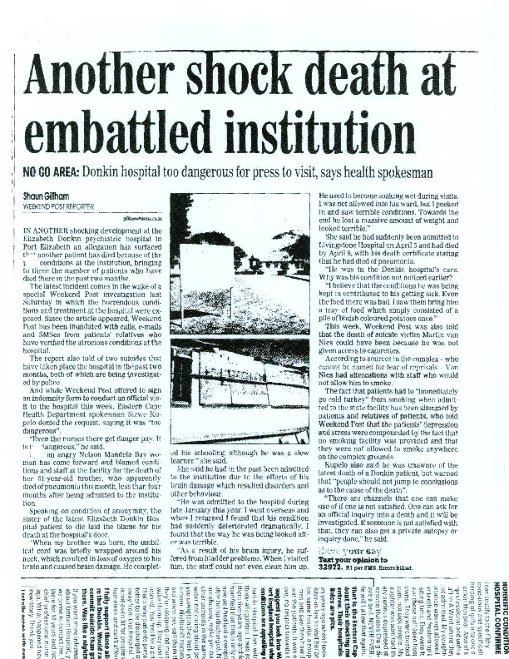

Slide 17
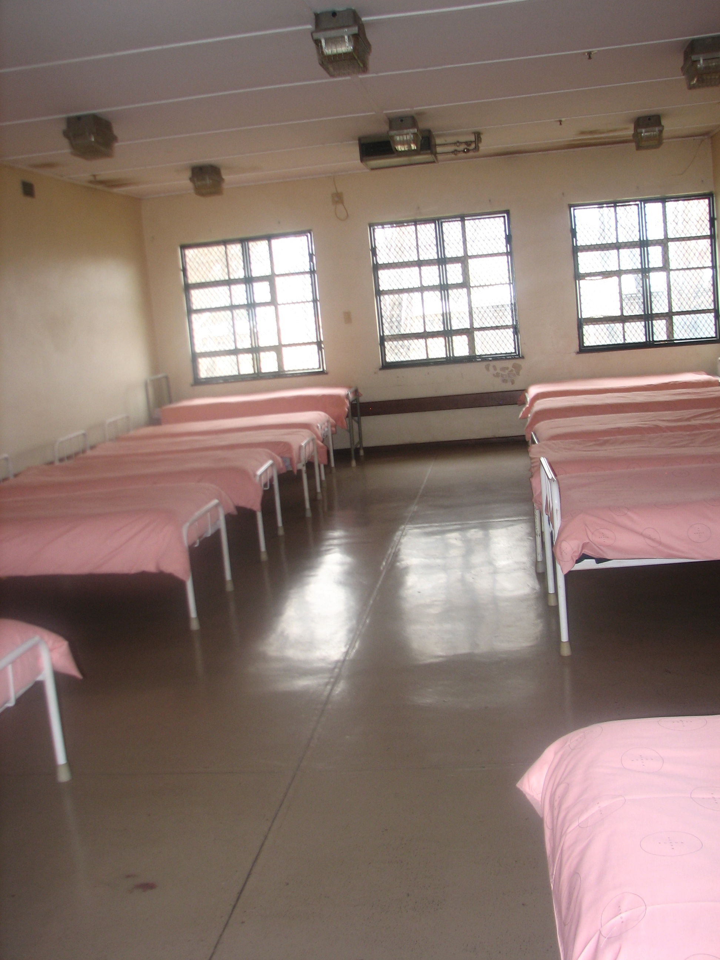

Slide 18
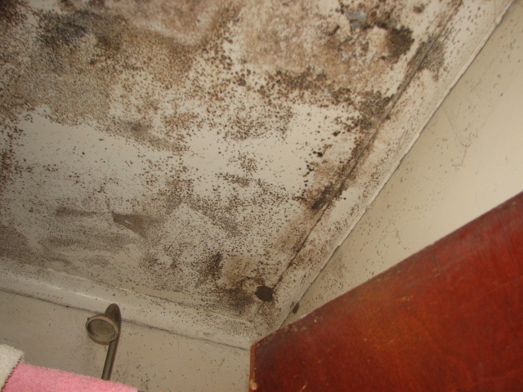

Slide 19
Social rights
The law was largely silent on social rights such as housing, employment etc as this was seen to be covered by different laws such as the employment equity act and the constitution.
Regulations to the act say that resources must be given to NGOs for them to provide services. (It doesn’t say how much though!)
At least 2% of all employees are meant to be disabled – but people with mental disability seem to have profited least.

Slide 20
Right to liberty
Law states in the preamble that it protects both people with mental disorder and the public where a person with mental disorder may be a danger to others (or self).
This means that involuntary care and treatment is permitted where a person’s ability to give informed consent to care treatment and rehabilitation has been impaired due to mental illness and after a number of processes for admission/treatment have been followed.

Slide 21
Involuntary category is used less often because of legal protections.
Mental disorder/intellectual disability is not the criteria for involuntary admission/treatment – the criteria is the user, due to mental illness, is unable to make an informed decision on the need for admission and treatment and refuses such admission and treatment.
And also that……“The user is likely to inflict serious harm to himself or herself or others, or care treatment and rehabilitation is necessary for the protection of the financial interests or reputation of the user”.

Slide 22
Review Boards
Review Boards consisting of a legal practitioner, mental health practitioner and a community member were set up.
This was largely set up as courts seldom if ever questioned the decisions of the medical practitioner under the previous legislation even though there was the right to appear in court.

Slide 23
Have Review Boards been successful?
Have mainly become paper based ( as permitted by the law) though appeals are made to appear before them and people can be represented by a lawyer. There is though a time delay before a person is seen in which they are kept without their consent.
There is constant change in the composition of the Review Boards and its hard to keep up with training new members.
Community member often wants to protect the community against the user rather than protect the person’s liberty.

Slide 24
Has involuntary community care been successful?
This section of the legislation has not been used as much as some people hoped and others feared. It has had “modest” impact.

Slide 25
Has the discharge of State patients improved?
Yes but….
The final decision is still made the Director of Public Prosecutions (Attorney General) and they don’t always act on the advice of the psychiatrist and the review of mental health status.

Slide 26
Summary
Has the Mental Health Care Act improved the human rights of people with mental disabilities? Yes
Has the legislation had as much impact as it could have had? No

